Slide 1
Lesson 8: Graduation
Notes:
(Instructor Guide pages 115-119)

Slide 2
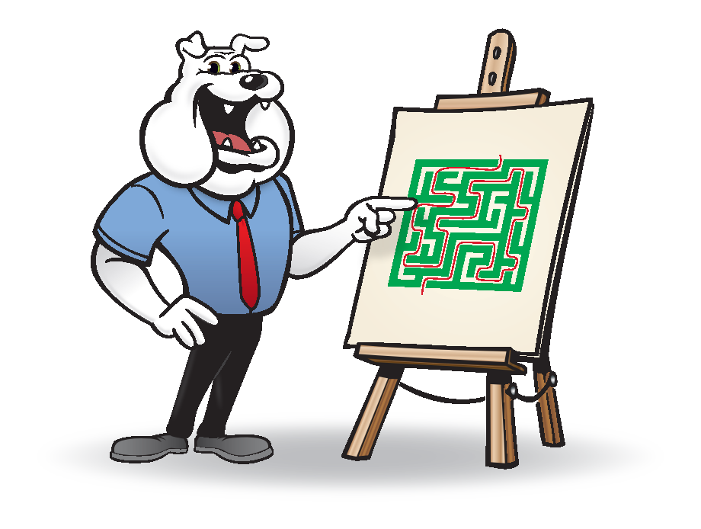
Test Time
Notes:
Say: We will now test what you learned from the babysitter’s course…

Slide 3
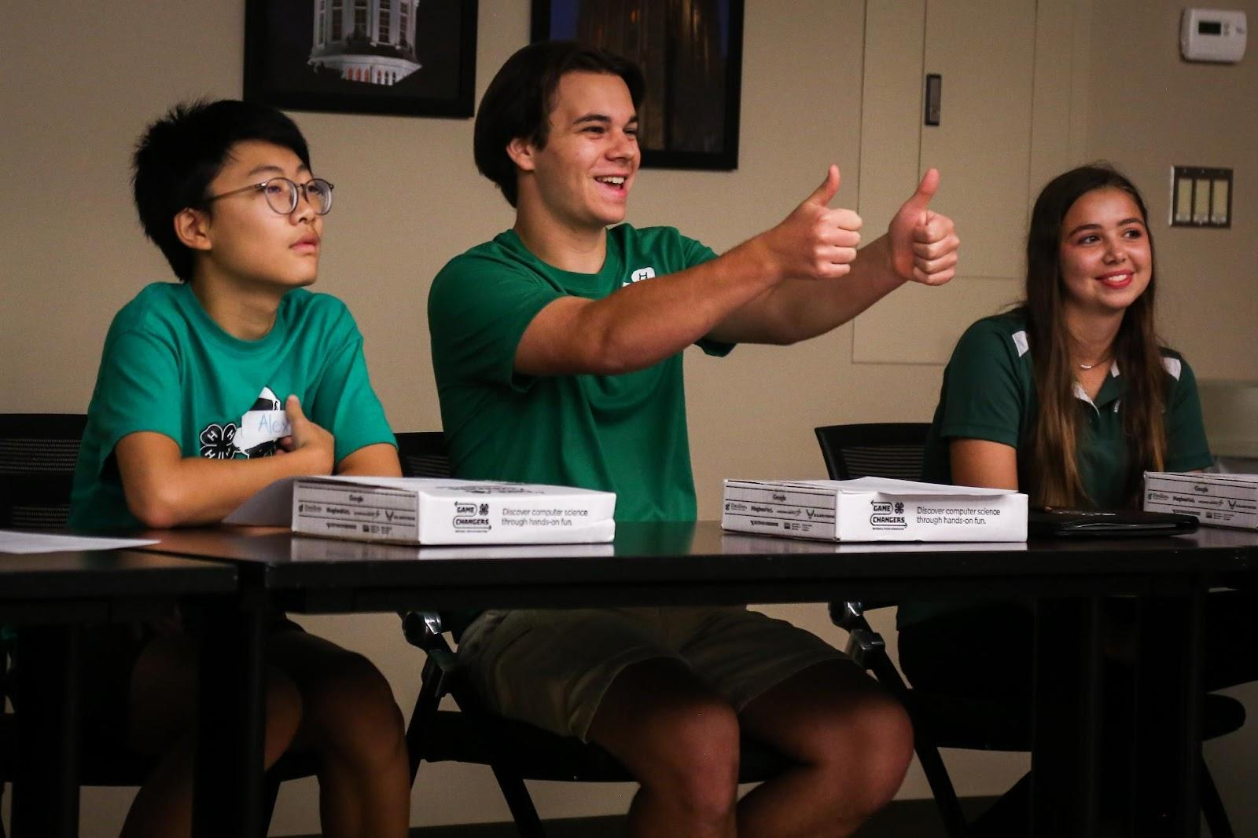
Role-play and Situation Activity
Activity Options:
Role play safety situations with a partner
Write down what you would do in specific safety situations
Image from Microsoft PPT Stock
Notes:
Note: Activity Options:
Role play safety situations with a partner
Write down what you would do in specific safety situations (Be sure to have paper and writing utensil available per child)
Say: Our selected activity will address your critical thinking skills and problem-solving skills. We will respond to the scenarios and then discuss after we had time to consider each situation. (Explain activity instructions based on the selected activity and space)
(Instructor Guide page 117)

Slide 4
What would you do if…
Someone knocks on the door and wants to come in. He identifies himself as the next-door neighbor, but you have never seen him before.
Image from Microsoft PPT Stock ​
Notes:
Say: Someone knocks on the door and wants to come in. He identifies himself as the next-door neighbor, but you have never seen him before. (allow time for youth to consider and respond)
Do: Allow youth to share their perspective and ensure their response is appropriate. As needed expand on proper steps and provide further support or example to help youth understand the correct steps.
(Instructor Guide page 117)

Slide 5
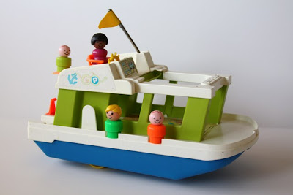
What would you do if…
The one-year-old you are babysitting for is playing with a toy that you feel is unsafe. It has small parts that look like they could come off.
Image from Microsoft PPT Stock ​
Notes:
Say: Now, let's consider if the one-year-old you are babysitting for is playing with a toy that you feel is unsafe. It has small parts that look like they could come off.
(Instructor Guide page 117)

Slide 6
What would you do if…
The 3-year-old you are watching has missed her nap and explodes into tears when her parent/guardians leave for the evening.
Image from Microsoft PPT Stock ​
Notes:
Ask: Are you ready for your next scenario?!
Say: The 3-year-old you are watching has missed her nap and explodes into tears when her parent/guardians leave for the evening.
(Instructor Guide page 117)

Slide 7
What would you do if…
You are trying to get the one-year-old down for his nap when you notice the three-year-old is gone and the front door is open.
Image from Microsoft PPT Stock ​
Notes:
Say: Our last scenario to consider is the following, What would you do if you are trying to get the one-year-old down for his nap when you notice the three-year-old is gone and the front door is open.
(Instructor Guide page 117)

Slide 8
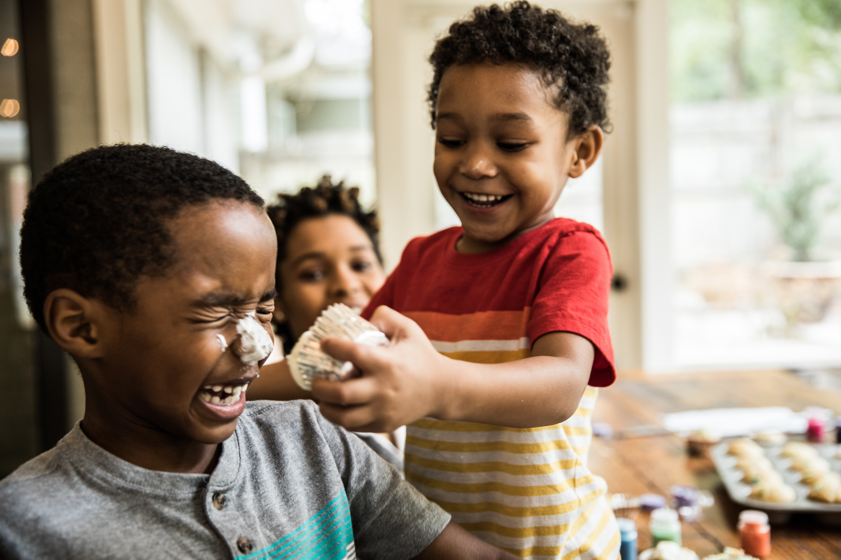
Congratulations!
Images from Microsoft PPT Stock ​
Notes:
Note: This is a huge accomplishment for the teens to finish this curriculum. They are able to have transferable knowledge no matter where they go. Make sure to emphasize their accomplishment as much as you can. Consider providing certificates and a babysitting toolkit to support their next steps. Adapt this slide to showcase the teens in your class and highlight the skills they learned throughout the sessions. Youth love to see their pictures, so take 10-minutes before the session to upload session pictures to highlight this big moment.

Slide 9
Media Presentation Created By
UGA FACS Family Life Education Methodology students: Amy Chang, Mackenzie Gay, Elaine Metcalf, and Melina Patterson
Laura Goss, Georgia 4-H Military Liaison from the University of Georgia College of Agricultural and Environmental Sciences Cooperative Extension
McKenzie Tankersley, AmeriCorps Volunteer in Service to America member with Georgia 4-H

Slide 10
Resources
4-H/Army Child & Youth Services Instructor Babysitting Guide, Pages 115-119
Stock Images. (2022). Microsoft PowerPoint.
An Equal Opportunity, Affirmative Action, Veteran, Disability Institution
Notes:
(Instructor Guide pages 115-119)

