Slide 1
LESSON 6
ENTERTAINMENT WHEN BABYSITTING
Notes:
Say: Today we are going to talk about entertaining the children during your time of babysitting
(Instructor Guide pages 97-106)

Slide 2
LET'S TALK!
What are some activities you can do with kids in different age groups?
Notes:
Say: Let’s talk about some of the different activities that you may be able to with kids in each of the different age groups; can allow students to brainstorm ideas before proceeding.
Say: These activities could include a variety of different types like physical or mental exercises, such as hands-on activities, physical activity, or even sleep routines.
Say: However, we need to keep in mind that there are different activities for different age groups. Sometimes you may need to spend more time entertaining younger children than older children.
Say: Today, we are going to talk about what activities are most appropriate for each age range.
(Instructor Guide page 98)

Slide 3
Image from Microsoft PPT Stock Images​​​​​
BIRTH TO SIX MONTHS
What to know:
Enjoy cuddling
Interested in sounds
Enjoy looking at faces
allows them to learn emotions
Reading, singing, talking
Notes:
Say: From birth to 6 months, think about these activities, cuddling, making sounds like humming, or tinkling a spoon on a glass or crinkling paper. Some other things you could do could include making a variety of faces, reading, singing, and talking. Also keep in mind that newborns will grasp anything you place in their palms. So with this, be mindful!
(Instructor Guide page 100)

Slide 4
SIX TO TWELVE MONTHS
Read, Sing, Talk
Baby-safe mirror
Games
Repetitions
Notes:
Say: For kids within the age range of 6-12 months, you can do some of the stuff from the previous age range (birth to 6 months) like singing, talking and reading.
Say: Some other activities that you can do for this age group could include:
Playing games like Pat-A-Cake, Peek-A-Boo, rhymes (this little piggy..)
Repetition activities like Dropping or Reaching for things.
You could also Roll ball back and forth or do the like with an object.
Another thing you can try is hiding a toy or object under a blanket, and let the baby find it
Safe objects to put in and take out of box or basket
Lastly, like making noises, you could allow them to play with pots, pans, plastic containers under supervision.
(Instructor Guide page 100)

Slide 5
ONE TO TWO YEARS
Make-believe Play
telephone, miniature cars, trucks, and dolls
Simple toys
Blocks
Notes:
Say: For this age group (1-2yrs aka 12-24 months), you can participate in more activities that will support the child/ren’s motor skills and the like. Some of these activities could include playing make believe with them like telephones, acting like cars or trucks or even playing with dolls.
Say: You could also incorporate puzzles or things requiring pieces like taking part, putting together or even building of toys like Legos or blocks.
Say: Aside from the building, you could also participate in the same activities like singing, reading or talking. You could even make pickup or clean up time a game to help clean up after the day of play!
Say: If you want to do a inside house activity, you could play a game of hide and seek, letting the child/ren find you; you could also do this with other age groups above this one as well!
Say: Some other thing to keep in mind, this age group may begin to have favorite items like blankets, toys, etc. that may go with them everywhere.
(Instructor Guide page 100)

Slide 6
TWO TO THREE YEARS
Puzzles and construction toys
Scribbling, crafts
Matching toys
Make music
Outdoors
Quiet time
Reading time
Have Fun!
Image from Microsoft PPT Stock Images​​​​​​
Notes:
Say: This age group of 2-3yrs is developed a little more physically and mentally and will be able to start understanding concepts, patterns and the like.
Say: Some activities you can do for this age range could include more puzzles, like wooden ones, or matching of toys like pegboards. This age range also enjoys more creative freestyle activities like drawing, scribbling, stringing of beads, shaping playdough or other things and even making paper ring chains. This age group will also have a growing curiosity of the outside world, so sand boxes and water play activities could be of interest, but would also enjoy reading or quiet time. They may also like watching shows like puppet shows and letting them take part in those.
(Instructor Guide page 100)

Slide 7
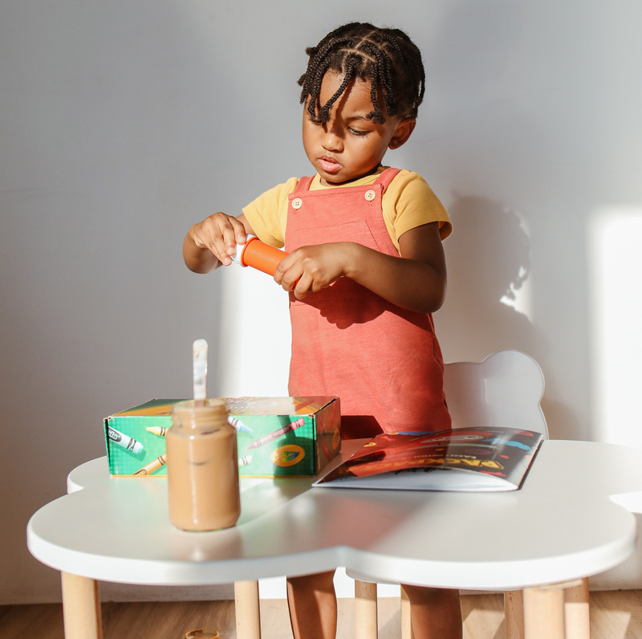
THREE TO FOUR YEARS
Roleplay
Crafts with clay, crayons, color books, finger paints, chalk, chalkboards, safety scissors
Board games
Take a walk outdoors
Make a fort out of blankets
Simple dice games
Image from Microsoft PPT Stock Images​​​​​​
Notes:
Say: For the age group of 3-4yrs, keep in mind attention spans during this age range might differ, but typically will be short, especially while watching tv or reading, but will oftentimes return their attention after a few minutes.
Say: Activities to use to keep attention for this age range could include things like role playing (play house or school), board games (Lotto, Candyland, Simon says, Statues, etc.) or even dice games.
Say: Other activities that may require more movement could be building a fort with them through use of blankets between furniture like chairs or create a line of chairs to mimic bus line and let them be the driver (could include other kids in this if applicable).
Say: Other physical activities could be to take the child/ren on a walk around the block and find and collect leaves, pinecones, or stones; could maybe even bring those home and use in a coloring, or craft activity later!
(Instructor Guide page 101)

Slide 8
FOUR TO FIVE YEARS
Interested in letters and numbers
Quiet time
Look at pictures
Dress-up
Do simple calisthenic (strength training) Activities
Active play outdoors
Notes:
Say: For the age group of 4-5yrs, there are even more great engaging things you can do with them! This age group will definitely enjoy a variety of crafts and indoor and outdoor activities!
Say: Some Craft activities could include creative things relating to numbers or letters, general words, and other popular activities that we talked about 3yr olds may like. Craft supplies like tape would be a good and creative resource to be used with this age group as well.
Say: Some other indoor activity examples would also include quiet, calm, or imaginative like craft activities could be things like conversating about wishes and dreams. Another thing you could do is have them look at family pictures and let them show you who everyone is in some pictures of theirs. You could also play dress up with them; wearing hats and masks made from paper bags. With these bags, you could allow them to cut holes supervised or you do it yourself and let them decorate the bag to be a hat or mask of their choice!
Say: Other activities that could be done inside or outside could be things like stretching or exercising. We have Calisthenic activities; this is what we call strength, endurance, flexibility and coordination building activities that only use body weight, no equipment needed. You could do things like jumping jacks, jumping rope or just things like bending, stretching or even dancing!
Say: Some more outdoors activities could include things like hopscotch, hide and seek, tricycle or bike riding, timed runs around the house, neighborhood, or yard, and even playing with chalk on the sidewalk!
(Instructor Guide page 101)

Slide 9
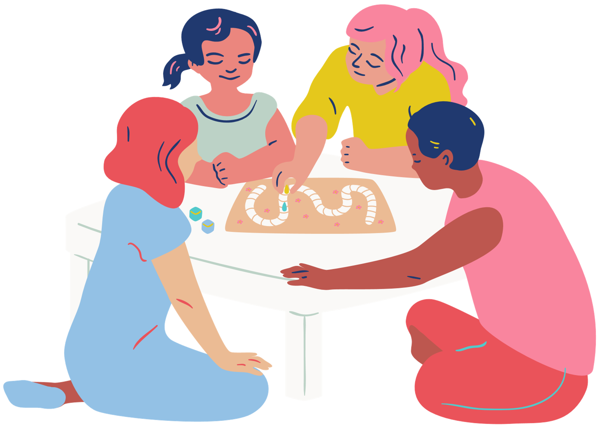
FIVE TO SEVEN YEARS
Outdoors
Read to you or with you
Playing with dolls, playing dress-up, manipulative toys, and construction materials
Board games
Make up a silly song with the child/ren
Notes:
Say: The last big age group we will touch on today is the 5-7 yrs. old age group. Within this age group, you may find that you do not need to entertain this child as much as the other age groups. They start forming independence and sense of self in this stage of their development. However, there are still things you can do with them.
Say: Similar to the last age group, introducing exercises like calisthenics would get them active. So doing things like jump roping, running games (like tag or playing catch), and riding bikes or teaching them to ride a bike (great if you can, you don’t have to but it would be teaching them a new skill!). Keep in mind, they may want to do these things with neighborhood friends, which is okay if parents are okay with it, but I would try and supervise when you can. You could try to do these things with the other kids, including them or tagging along as well, but don’t force any interactions unless necessary.
Say: Other activities that are better inside could include letting the child/ren read to you or with you. You could also pose them riddles for them to try and figure out. You could also play board games much like the other ages; some good games could be checkers, uno, Life, etc. But keep in mind, they like to win and may not know all rules. While games will keep them engaged, having them play with toys they can manipulate or construct like Lego sets or puzzles could also keep them busy for hours! In addition to the games, you can also play dress up and just be goofy and make up silly things like songs or dances as well.
Say: Now that we know what each age group might be interested in, lets think about toys and what we should look out for when providing for or supervising the use of toys.
(Instructor Guide page 101)

Slide 10
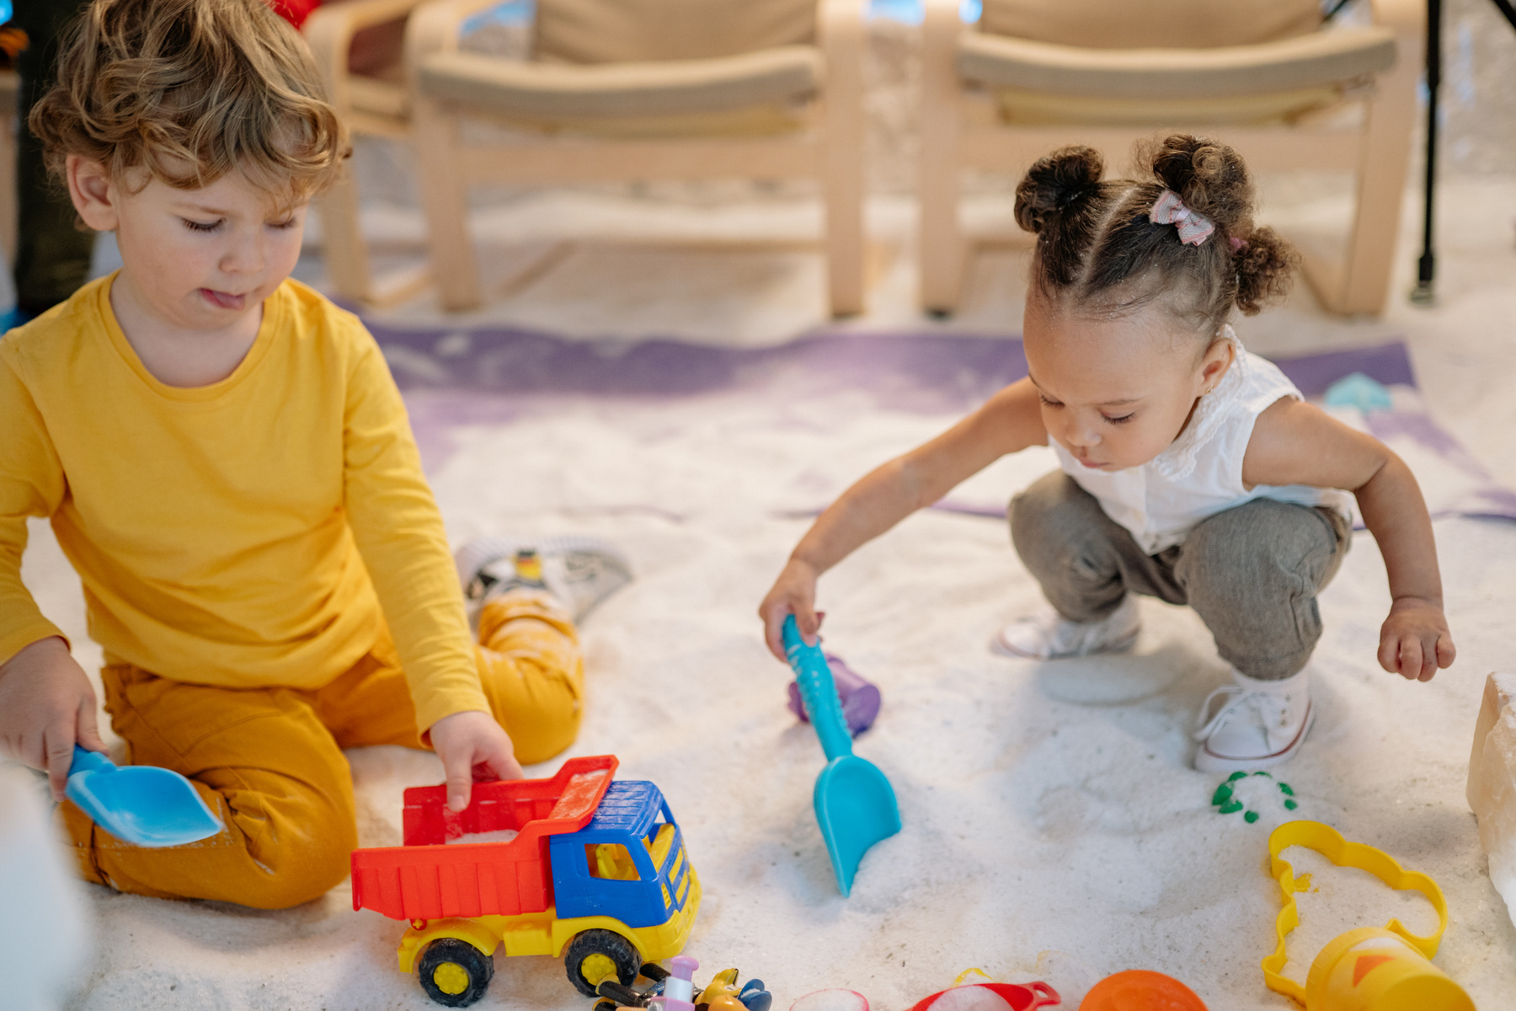
REFLECTION TIME
Think, pair, share
What were some of your favorite toys as a child?
Do you think those toys were safe?
Image from Microsoft PPT Stock Images​​​​​​
Notes:
Say: Take a moment to think back to when you were younger, what were some of your favorite toys? Also think about how safe you think the toys were as well?
Say: Now let things about your toys and see what toys you should be provided!
(Instructor Guide page 101 and/or 104)

Slide 11
WHAT KIND OF TOYS?
Toys should:
Be fun
Increase their skills
Help them learn
Encourage creativity
Build concentration skills
Notes:
Say: Some of the toys you can provide should be fun in some type of way. Toys should also help increase their mental or physical skills like concentration or help them learn about the world around them. You want the children to be able to have a safe environment to express themselves and be creative with their toys and environment. However, some toys are better in certain instances than others. We're going to talk about that next.
(Instructor Guide page 105)

Slide 12
TOYS FOR CERTAIN TYPES OF PLAY
Consider what toys are appropriate for...
Active play
Quiet play
Solitary play
Sharing play
Activity
Interview a partner and try to think of at least two toys for each type of play (no repeat toys)
Notes:
Say: Some toys are better fit to be used to play actively. Some examples might include things like push and pull toys, wheel type toys, or sport items.
While these toys are appropriate for outside or active playing, other toys like puzzles may not be the best fit.
Say: So things like puzzles, building blocks, dolls or other constructive toys would be more along the lines of quiet play types of toys. Similarly, some of these quiet type toys can also be a type of solidarity toy. A solidarity toy is something that can be done independently. So things like arts and crafts, books, finger painting, modeling clay or even puzzles can fall into this category.
Say: While these activities can be done alone, other types of play like sharing require different types of toys. Some examples of sharing play toys are things like boardgames like Checkers, or other noncompetitive games like a scavenger hunt or Simone Says.
Note: Activity similar to Toy Show and Tell on Instructor guide page 104
(Instructor Guide page 105)

Slide 13
Image from Microsoft PPT Stock Images​​​​​​
THINGS TO CONSIDER WITH TOYS
When picking a toy for a child to play with, it is important that it is:
Age-appropriate
Safe for the child!
Let's consider the following:
Age recommendations
Be careful and intentional with toy selection!
Notes:
Say: So now that we know some different types of toys and the right times of play to offer them, lets talk about some things you need to consider when looking for or choose toys to provide.
Say: One good way is to look at the age recommendations on the packaging of the game or toy (for example: may be too advanced for a three-year-old).
Say: With age appropriateness, you also want to keep this in mind when doing things like crafts or other activities that may require more of a responsible age group. So if you are doing crafts involving cutting or hot gluing, you may need to supervise and offer these activities to ages over 8 years old Another thing you can do is to pay attention and learn what fascinates the child/ren and choose toys based on their interests.
Say: But overall, practice being careful and intentional with your toy selection!
Say: So now we have touched on general things to consider, lets discuss on hazards to consider as well.
(Instructor Guide page 105)

Slide 14
LET'S TALK
What are some potential hazards to look for in toys?
Image from Microsoft PPT Stock Images​​​​​​
Notes:
Say:: now we have considered some general things to consider when providing toys, lets discuss some potential hazards you might need to consider as well?
Say: Allow students to present their ideas of what to look for and then review correct and relevant points below:
Say: Great Ideas! Yes! We want to look for: sharp points, jagged edges, rough surfaces, glass objects or surfaces that could break and leave sharp cutting edges, along with sharp spikes or pins that become exposed if someone pulls the toy apart.
Say: We also want to keep in mind the small detachable parts that may loose or removed like squeakers, noise makers, things like Legos or other things around the house like nuts, bolts and clamps that may not be tightly securely attached to a toy or could be removed could be swallowed or could lodge in the windpipe, nostrils, or ears.
Say: Other things to consider include
Long cords or strings,
Cap, guns, and other toys that produce a very loud noise that could impair hearing
Outdoor play equipment that are not on a level surface or anchored properly
Items with missing parts or pieces
Poorly constructed dolls and animals stuffed with small pellets that will fall out when the seams are opened
Say: There are a lot of different types of hazards to look for and consider in toys. If you would like to have a check list type resource, we can look at the Toy Safety Checklist (p106) to help guide you guys.
(Info about hazards is in the Instructor Guide page 105)
(Refer to Instructor Guide page 106 for “Toy Safety Checklist” if needed)

Slide 15
MEDIA PRESENTATION CREATED BY
UGA FACS Family Life Education Methodology students: Amy Chang, Mackenzie Gay, Elaine Metcalf, and Melina Patterson
Laura Goss, Georgia 4-H Military Liaison from the University of Georgia College of Agricultural and Environmental Sciences Cooperative Extension
McKenzie Tankersley, AmeriCorps Volunteer in Service to America member with Georgia 4-H

Slide 16
REFERENCE
4-H/Army Child & Youth Services Instructor Babysitting Guide, Pages 97-106
Stock Images. (2022). Canva. www.canva.com
An Equal Opportunity, Affirmative Action, Veteran, Disability Institution

