Slide 1
Lesson 5
Food & Nutrition
Notes:
Say: Welcome to our session on Food and Nutrition!
Do: take role if needed.
(Refer to Instructor Guide pages 87-96)

Slide 2
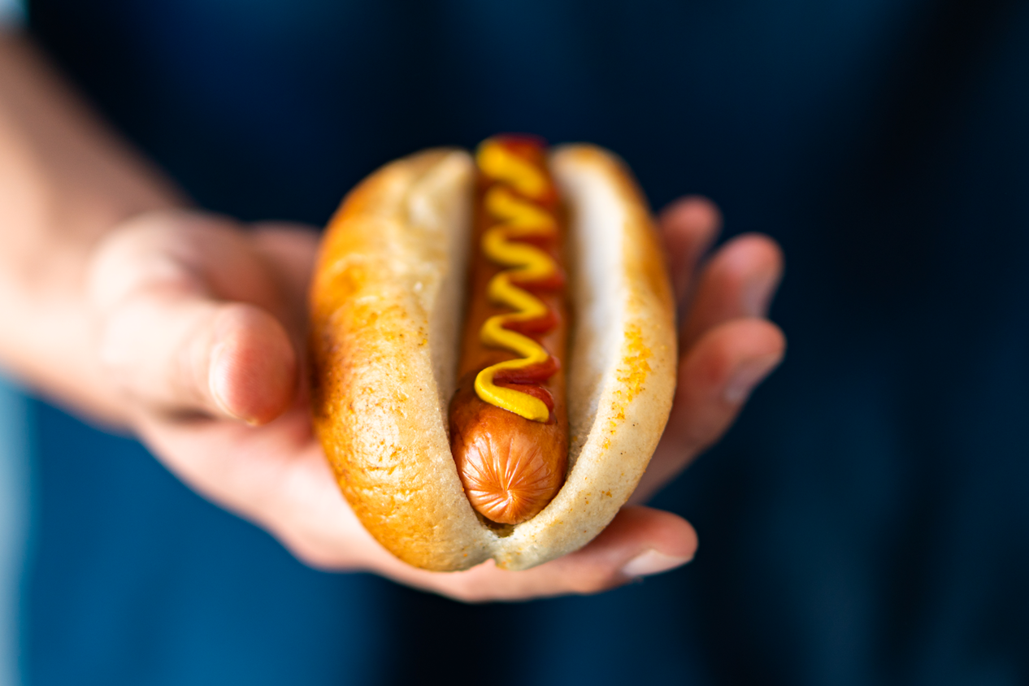
Safety
What should you keep in mind when around food?
What are good safety habits while in the kitchen?
What are good safety habits when using appliances?
Image from Microsoft PPT Stock Images​​​​
Notes:
Say: Before we jump in, lets see what you guys think about these questions.
Say: The first one, What are some things you should keep in mind when you are around food?
Hygiene
Allergies
Possibly sharp objects like bones, knives or other utensils in the kitchen
Say: Next think about what are some good safety habits to have while in a kitchen?
Washing hands
Washing utensils between use to prevent contamination
Checking for food allergies
Say: And lastly, think about best practices for kitchen appliances.
Don’t leave children unattended around hot surfaces or objects
Being aware of caregiver restriction on the use of such appliances, etc.
(Instructor Guide page 88)

Slide 3
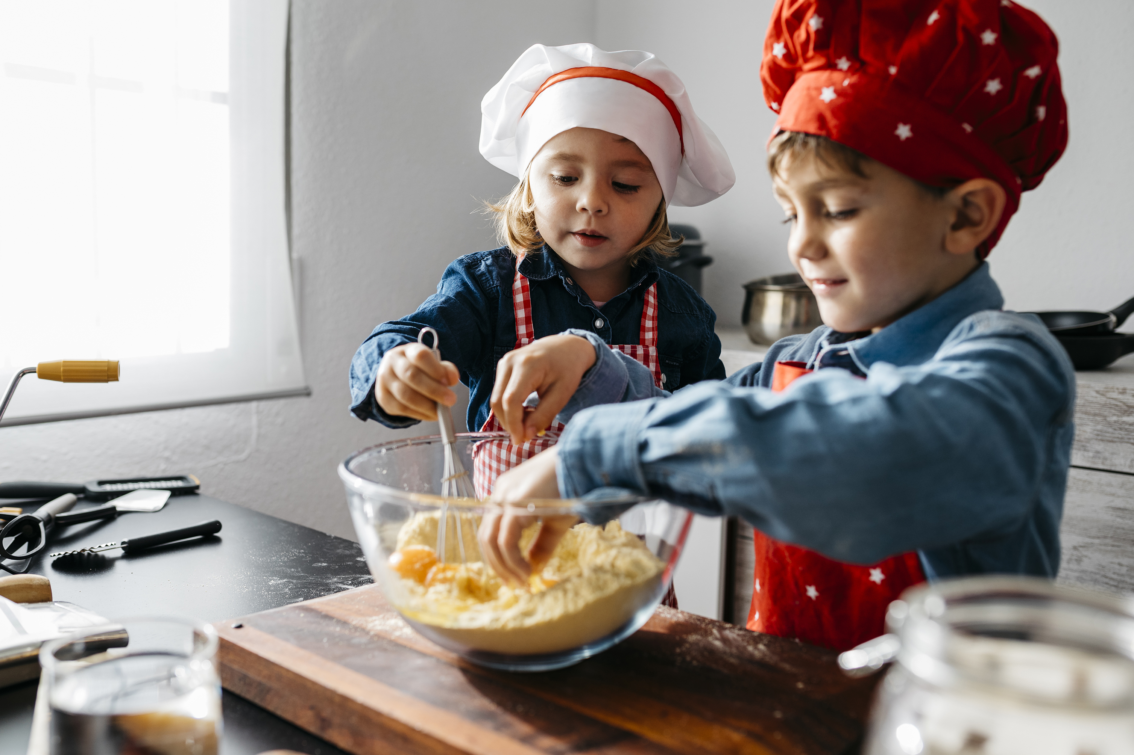
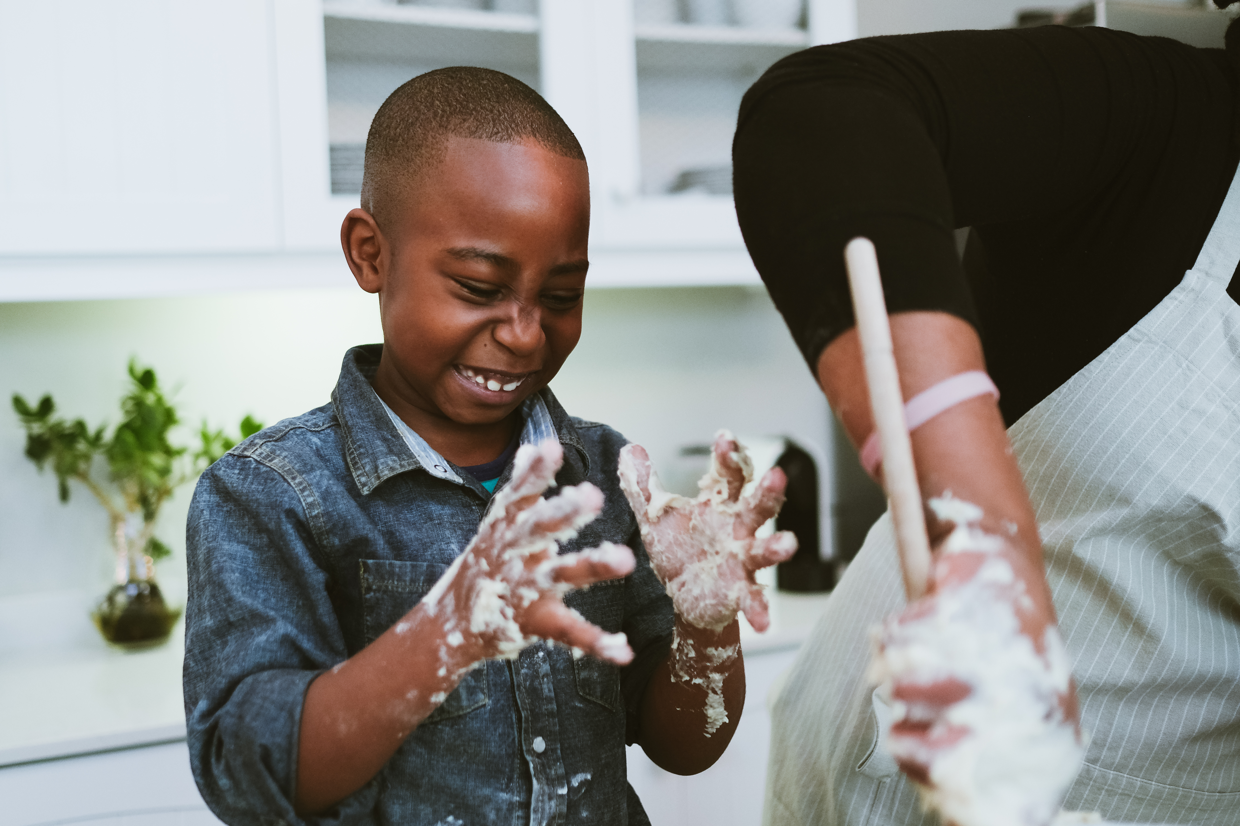
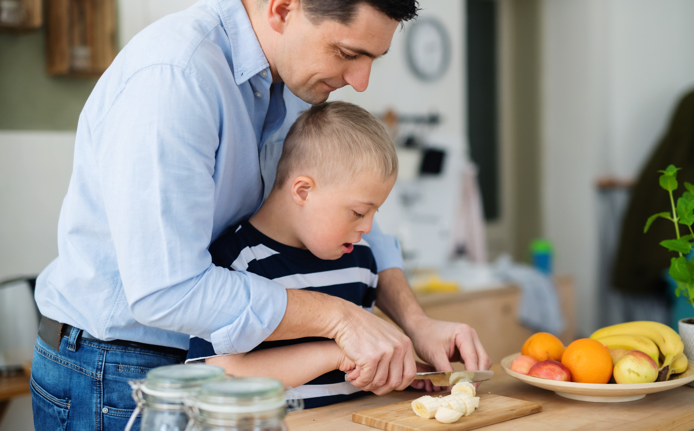
Safety Activity: Interview
Interview your neighbor(s) about their family's kitchen rules.
Images from Microsoft PPT Stock Images​​​​​
Notes:
(Optional activity for extended pair-share engagement)
Say: As a babysitter you can learn about different families' routines and traditions within the home. It’s important to respect those expectations and roles while you are in their home. To begin to learn about family differences within the kitchen, choose a partner to discuss their family kitchen traditions or roles. To make it more fun, let’s conduct this as an interview! Be sure to have a pretend microphone and point the mic (demonstrate like a broadcaster) when asking questions. Remember to switch the interview after about 3 minutes, so both partners can share. You might ask questions in your interview like: Who in your family cooks the meals, what type of meals does your family eat, where does your family eat most often, do children clean up the dinner table after meals…
(Activity Adapted from Instructor Guide Page 88)

Slide 4
Safety First
What should you ask the parents about kitchen use and safety?
What safety habits should you be using when children are about to eat, during eating and after eating?
What sanitary practices are important?
Image from Microsoft PPT Stock Images​​​​​
Notes:
Say: Get with a partner and share your ideas of common babysitter mistakes and different things you might want to avoid when preparing, providing, and overseeing youth while in the kitchen. For example, leaving a child alone when eating food or giving infant grapes without cutting them.
Say: The bullets on the screen provide topics for you and your partner to consider.
(pause and allow time to discuss)
As a review here are few things to you Should do related to food prep:
Be sure to ask parents if the child has any food allergies or foods to avoid. This might include proper cutting of food for their child or that their child cannot have figs.
Stay with the children when they eat to ensure they do not choke and to better avoid choking altogether
Avoid small hazardous foods like grapes, candies, nuts, and sticky foods like peanut butter too.
Wash your own hands and the children’s before and after eating. No one wants sticky toys and especially sticky furniture.
If there is ever any question if a child can have food or not it is better to be safe than sorry and not give it to them. Ask the parent before providing the food.
(Instructor Guide page 88)

Slide 5
Preparedness
Take a tour of the kitchen with the parent(s) before they leave
Ask about their cleaning routine
Understand the child's expectations within the kitchen
Image from Microsoft PPT Stock Images​​​​​
Notes:
Say: If you have never babysat for the family, it can be important to understand where supplies are located in the kitchen. Let’s talk about a few helpful things to do to prepare for your role within the kitchen as a babysitter.
Say: You can do the following:
Take a tour of the kitchen with the parent(s) before they leave
Practice working the needed appliances to make sure you know how to use them safely.
Ask what their cleaning routine is after cooking or preparing food like hand-washing dishes or using the dishwasher.
If babysitting older kids, see what their knowledge and role is in the kitchen
For example, are the youth expected to clean off the table or wash dishes?
(Tour note not in Instructor Guide, adapted activity)
(Other relative info can be found on Instructor Guide page 90)

Slide 6
Healthy Food Choices
Create a chart like this one on a piece of paper and answer each category with your top 5 food choices for each one.
Grains
Vegetables
Fruits
Dairy
Meat/Beans
Combination food
Notes:
Note: For this activity you will need paper and writing utensil.
Say: Let’s practice! (either do as a group or have youth create a chart on paper)
Say: On a piece paper draw the chart you see on the screen.
(pause for them to draw).
Now, fill in examples of food items that you can give to an infant (which is a child between 6-12 months).
Grains: Whole grain bread, cereal, crackers, and pasta
Vegetables: cucumbers, squash, green peppers, broccoli, cauliflower, etc. (infants can eat these cooked)
Fruit: oranges, apples, bananas, pineapples, and canned fruit packed in 100% juice
Dairy: Milk, yogurt, and cheese
Protein: Lean meat, fish, beans, chicken and eggs
Combination foods: like soups, pizza and macaroni and cheese
Say: Other things you can consider:
Peanut butter: It is a good source of protein, but be sure to ask parents if you can give peanut butter before providing it to a child since it is a common allergy food.
Milk: in addition to the peanut allergy check if the child may have a lactose intolerance to avoid any stomach issues while babysitting.
Say: Now look at your chart and consider if there are certain items babies cannot have. (pause)
(Instructor Guide pages 90 and 91)

Slide 7
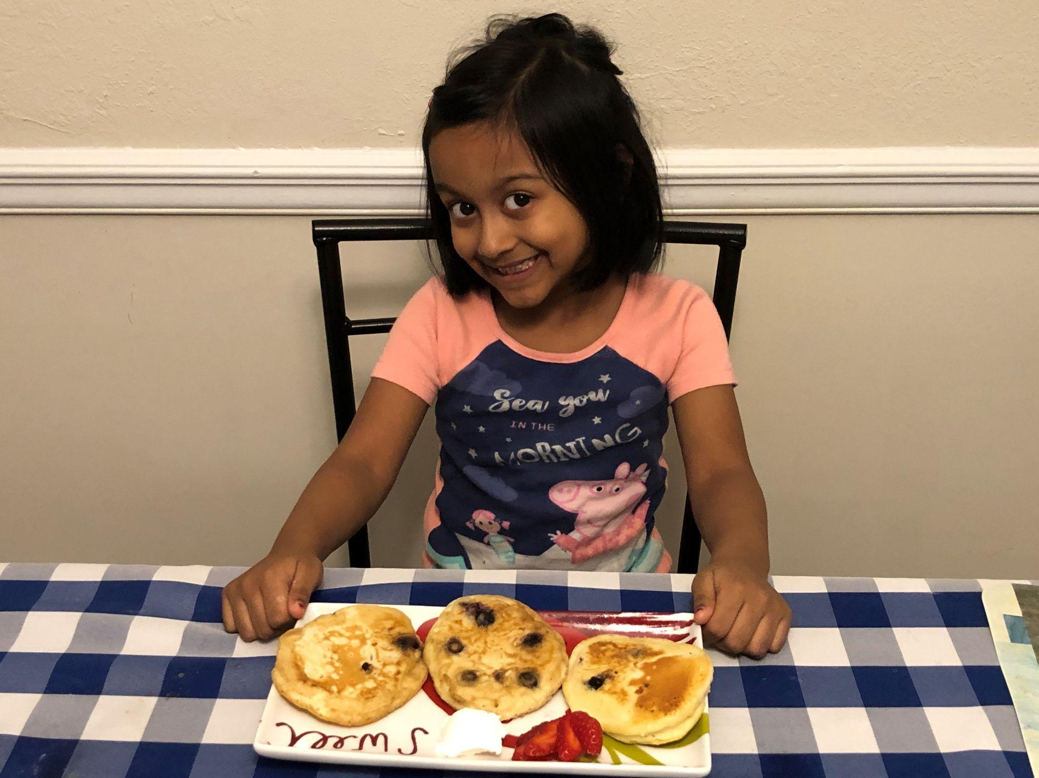
Healthy Choices
What are some healthy food choices for children?
How might eating habits differ between ages?
Image from Microsoft PPT Stock Images​​​​​
Notes:
Ask: What do you think are some healthy food choices for children?
Say: Some good food choices for children and adults can include whole grains, vegetables, fruits, dairy, and protein.
Ask: How might eating habits differ between ages?
Say: think about how infants may need softer and smaller amounts of food, and as children get older they will need a larger amount of food in a larger variety of forms.
(Instructor Guide Pages 90 and 91)

Slide 8
Newborn
Notes:
Say: Newborns are considered babies that are between zero to six months old. At this age, babies are not eating food.
Say: So what are they eating? (pause for response) That’s right milk in the form of breastmilk or formula. The best way to prepare for caring for a newborn is to speak with the parent about their child’s feeding schedule. Babies can be on a routine and depending on the month, might eat every 3 hours or so. So, if you are watching a newborn request the parents to provide detailed instructions on feeding times and amounts of milk.
(Instructor Guide page 92, with a detailed chart for each age group provided)

Slide 9
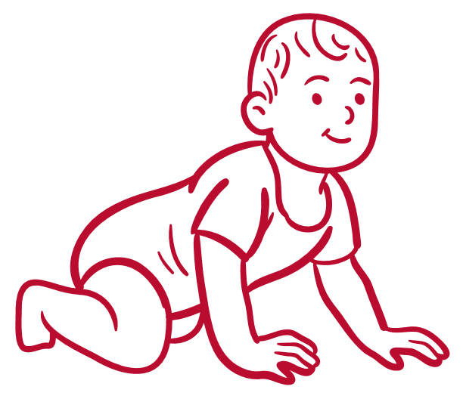
Infant
Notes:
Say: Infants, babies that are between six to 9 months, are beginning to eat solid food. However, remember to confirm with the parent what foods you may feed the baby. Be sure to give small amounts at a time. Babies tend to stuff food into their mouths, which can be a chocking hazard. Therefore, you should try and provide small amounts of food to the baby. Never warm a babies food in microwave, because of common hot spots that can occur with microwaving food. So ask parents if they warm food for the child, and if so, how.
Say: Can someone share common finger foods infants may enjoy at this age?
(pause)
Possible answers: cereals, crackers, and toast are a few examples.
But try and check with the caregiver on specific foods
(Instructor Guide page 92, detailed chart for each age group provided)

Slide 10
Older Infant
Notes:
Say: Older infants are around 10 to 12 months. By this age infants are more comfortable with different textures and flavors of food along with eating more food in general. Often infants are eating the same food as their families by this age. Common foods include cottage cheese, small pieces of peeled fruits, graham crackers, cooked veggies, scrambled eggs, and small pieces of meat.
Say: When babysitting, offer the baby small amounts of food and provide more if he/she like it.
(Instructor Guide page 92, with detailed chart for each age group provided)

Slide 11
Toddlers
Notes:
Say: Toddlers are between 1 and 3 years of age. Children at this age love to explore and show their independence.
Say: Toddles often want to eat the same foods again and again or will refuse food with a loud “no!”
Say: As a reminder, the parents know their children well, so never hesitate to reach out to ask what the toddler's favorite snack or food is. You want the child to have a good experience with you, so it can be helpful to continue to ask parents about their child's eating habits.
Ask: Who likes snacks in this room?! Don’t we all! Well, toddlers love snacks too and it helps them keep their energy up. Their stomachs are smaller than ours, so small snacks help them stay happy and full. Of course, cheese-its are not the best snacks so you will want to try and incorporate proteins, fruits, dairy, and veggies into snack time.
(Instructor Guide page 92, with a detailed chart for each age group provided)

Slide 12
Preschoolers & School-aged Children
Notes:
Say: Like our toddlers, this age group needs snacks too, in addition to healthy meals throughout the day.
Ask: What ages are we looking at now if I say Preschooler and School-aged?
Say: That’s right preschool is 3 to 5 and School-aged is 6 to 11. This might be one of your more common age groups to watch as parents begin to be more comfortable with teens babysitting these age groups. Part of the comfort level is often is attributed to preschoolers being generally potty trained at least during the day and both age groups' common allergies are generally known by this time.
Say: Something to keep in mind with preschoolers is they have a clear idea of what they will and will not eat. Trying new foods can be hard, so do not force the child while babysitting. We want mealtime to be a positive experience.
Say: The school-aged children are generally positive, curious, and energetic about meals and snacks. Provide options with food to allow the child some form of independence and control.
(Instructor Guide page 93, with a detailed chart for each age group provided)

Slide 13
Do’s:
Don’ts:
Have food ready at usual eating times
Use a high chair if necessary
Provide nutritional foods
Eat with the child
Force the child to eat if they don’t want to
Leave the child alone while they are eating.
Give the child any food they aren’t able to chew.
Notes:
Say:
Do’s
DO! Have food ready at usual eating times to avoid fussy/hungry children.
DO! Use a high chair if necessary!
DO! Good nutritional foods are important.
DO! Eat with the child at the same time to encourage them.
Don’ts
DON’T! Don’t force the child to eat if they don’t want to, but let the parents know when they get home if the child didn’t eat.
DON’T! Leave the child alone while they are eating.
DON’T! Give the child any food they aren’t able to chew.
(Instructor Guide pages 89-93)

Slide 14
Share
What is one thing that you learned from this session?
Notes:
Do: Conduct a reflection from this lesson to ensure understanding and answer any questions that come up.

Slide 15
Media Presentation Created By
UGA FACS Family Life Education Methodology students: Amy Chang, Mackenzie Gay, Elaine Metcalf, and Melina Patterson
Laura Goss, Georgia 4-H Military Liaison from the University of Georgia College of Agricultural and Environmental Sciences Cooperative Extension
McKenzie Tankersley, AmeriCorps Volunteer in Service to America member with Georgia 4-H
An Equal Opportunity, Affirmative Action, Veteran, Disability Institution

Slide 16
References
4-H/Army Child & Youth Services Instructor Babysitting Guide, pages 87-96
Stock Images. (2022). Microsoft PowerPoint.

