Slide 1
LESSON 3
FIRST AID
Notes:
Note: This topic is a great one to invite a quest speaker for, so these slides might serve to capture what the guest speaker does not share. Also, keep in mind that depending on your local area and audience (on or off base) there might be different numbers and resources that should be shared. Please adapt this PPT and tools as needed.
Say: As a babysitter what is your job? (pause) That is right to keep the child safe. However, accidents will happen. If one does happen, remain calm, act quickly, call for help when needed, and stay with the child/ren until help arrives. Time is the greatest factor in an emergency. If you are prepared ahead of time, you can act immediately. Let’s learn about some ways we can be prepared.
(Instructor Guide Pages 45-60)

Slide 2
First Steps to Being Prepared
Know where you are and have the following recorded:
Location address
Phone Number of the Parent/Guardian
Know the on-post and off-post emergency numbers:
911
Military Police/ Security Forces
Fire Department
Request and record the neighbors name and number
Wear disposable gloves when treating injuries
Notes:
Say: Before we dive into the various What ifs that could occur let’s start with the first steps you should take before an emergency ever occurs.
Say: Know where you are and have the following recorded:
Location address
Phone Number of the Parent/Guardian
Say: Know the on-installation and off-installation emergency numbers
911
Military Police/ Security Forces
Fire Department
Say: Request and record the neighbors name and number
Say: Wear disposable gloves when treating injuries
(Instructor Guide page 46)

Slide 3
COMMON INJURIES
What Should you do if you encounter the following?
Minor Cuts
Nosebleeds
Notes:
Say: Let’s consider the following topics: Minor Cuts and Nosebleeds.
Have you ever experienced one of these and if so, how did you handle the situation?
(allow for responses and as needed share the following scripted response as a wrap up)
Say: With a minor cut, be sure wash with warm water and soap. Be sure to tell the parent when they come home about the injury.
Say: A nose may bleed from an injury to the nose or an object in the nose. If may start without warning, especially during the winter months in dry, heated homes. Have the child/ren sit straight with her or his head slightly forward and apply pressure by pinching the nostrils together for 5-7 seconds. Let’s practice (demonstrate and allow youth to practice).
Say: If the bleeding does not appear to be stopping or slowing, call the on-post or off-post emergency number or 911 for help. In all cases, call the parent/guardian. Do not allow the child/ren to blow his/her nose. Continue to pinch nostrils gently until help arrives.
(Instructor Guide page 47)

Slide 4
THINK & SHARE
What do you think are the most common injuries that occur while babysitting children?
Images from Microsoft PPT Stock Images​
Notes:
Ask: What do you think are the most common injuries that occur while babysitting children?
*allow time to share amongst the group
(Instructor Guide page 47)

Slide 5
AVOIDING A FIRE RISK
Don't smoke
When you cook, keep the pot handles turned inward
When you cook, never leave the stove unattended
Never light the fireplace or woodstove
Notes:
Say: Of course, we want to avoid fire. We can minimize the fire risk by doing what? Can anyone share one of the examples on the screen? (pause and allow youth to share)
Say: Let’s say a fire does occur and you are able to get the fire out without a professional what if the child begins to have trouble breathing, what should you do? (pause) call 9-1-1 and the parents.
(Instructor Guide page 47)

Slide 6
THINK AND SHARE
What do you do if a child gets burned?
Notes:
Say: What do you do if a child gets burned? (pause)
Say: One thing you should do is notify the parent. It is important to be as open and clear as possible when big and small accidents occur.
Say: If the burn involved more than one body part or is on the neck, head, hands, feet, or genitals you should call 9-1-1. Additionally, you should also call 9-1-1 if the burn was caused by chemicals, explosions, or electricity and if the child is exhibiting breathing troubles.
(Instructor Guide page 47)

Slide 7
Boo Boo Bunny
Let’s get crafty to help care for those we plan to babysit.
Notes:
Note: Follow the instructions on page 48, if you plan to include this activity.
Note: This is a tool that a babysitter can use to help with things like cuts and scrapes. It is meant to incorporate an ice cube in the loop of the bunny to provide ice without direct touch to the child's skin. Could also get the same effect through freezing it and then placing it on a cut.
(Instructor Guide page 48)

Slide 8
OTHER INJURIES AND ILLNESS
What should you do if you encounter the following:
Vomiting
Diarrhea
Notes:
Say: Vomiting can occur when children cry hard. If this happens, clean up the child. If crying is not the issue, clean up the child and notify the parent/guardian. Try to determine if the child is having abdominal pain. Always place the child on his/her side to prevent chocking.
Say: Diarrhea can occur due to something the child ate, illness such as flu, or a variety of other reasons. If this happens, put on gloves and wash your hands after you care for the child.
(Instructor Guide page 49)

Slide 9
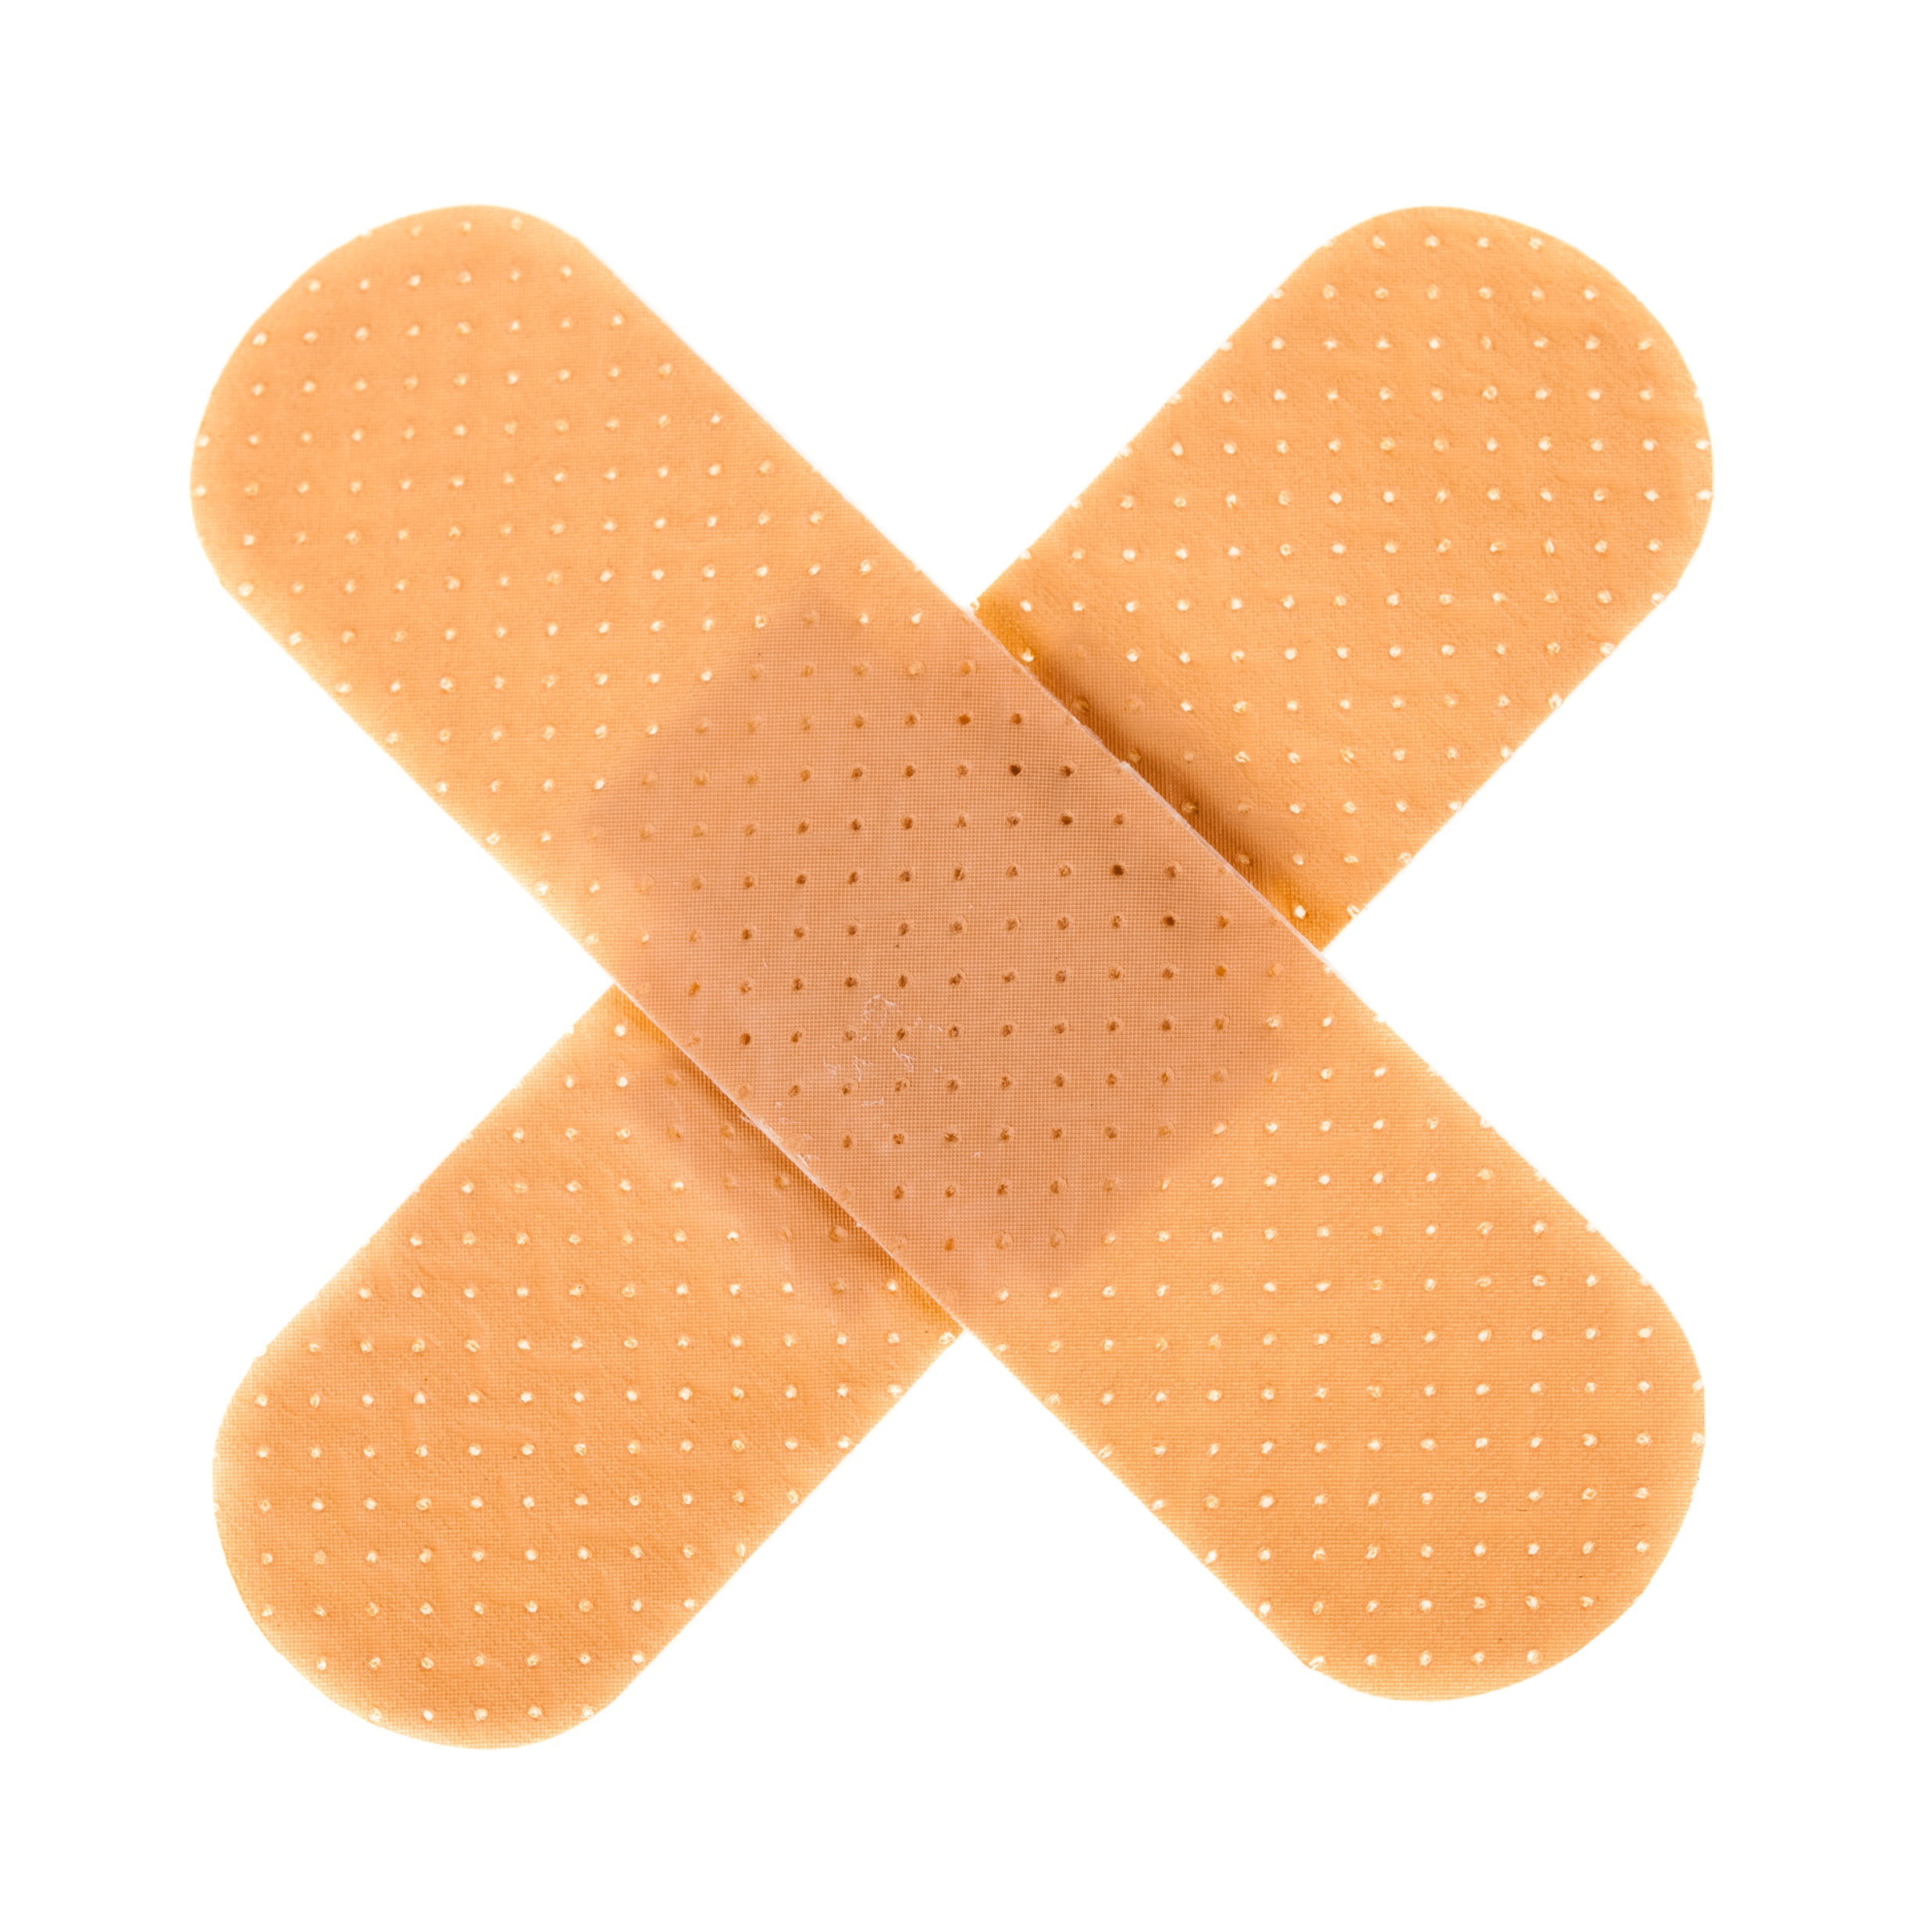
OTHER INJURIES AND ILLNESS
Notes:
Say: Beyond the previous injuries that could occur, I want you to consider other injuries that might happen. Let’s take 1-minute to silently write our ideas down. (pause for 1 minute)
Say: Now, as a group we will discuss possible injuries and how to handle those.
Note: Use page 49 – 50 to support the discussion and ensure that youth understand correct procedures while allowing for discussion.
(Instructor Guide pages 49-50)

Slide 10
CHOKING AND BLOCKED AIRWAYS
A child may stop breathing due to an illness or injury
A blocked airway is most often the cause of a blocked airway caused by a foreign object like:
small toys
pen caps
food items (hot dogs, grapes)
Notes:
Note: Use page 51 and 52 to teach this portion. It is ideal to have props for teaching this section. The most ideal situation is to have a certified instructor teach this section.
(Instructor Guide pages 51-52)

Slide 11
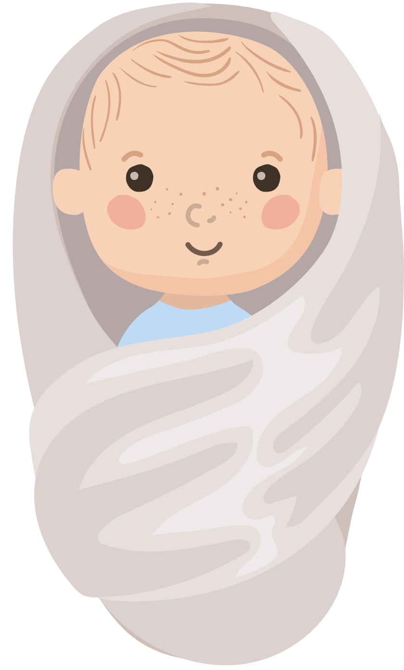
SUDDEN INFANT DEATH SYNDROME
SID is the unexpected and unexplained death of an infant under one year of age
Best practices for watching an infant:
Stay close to the baby
Use a baby monitor
Check on the baby
Place baby on their back
infants roll over between 4-6 months
Keep the room a comfortable temperature
No blankets, bottles, or toys in the crib
Notes:
Say: The American Academy of Pediatrics defines SIDS as the unexpected and unexplained of an infant under one year of age.
Some best practices to help mediate the risk are:
Try and stay close to the baby.
Utilize a baby monitor.
Frequently check on the baby, even if sleeping.
When laying a baby down, remember to place a baby on their back, but infants between 4-6 months they may roll over.
Try to keep the room they are in at a comfortable temperature
And lastly, make sure there's no blankets, bottles or toys in the crib of the baby
(Instructor Guide page 53)

Slide 12
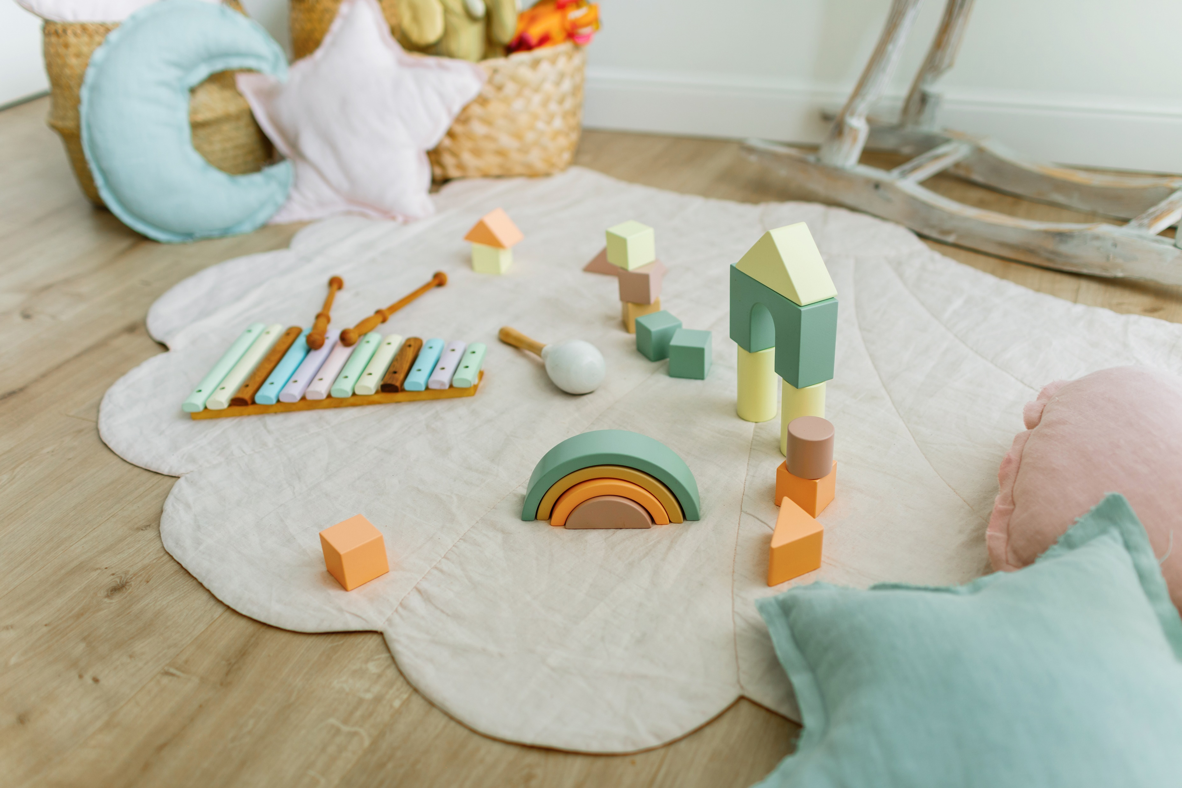
Tummy Time
Image from Microsoft PPT Stock Images​
Images from Microsoft PPT Stock Images​​
Notes:
Say: Babysitters should interreact with the children! One, because it is fun and two it is a great way to keep the children safe and engaged.
Say: When babysitting an infant, it is ideal to get on the floor with babies to maintain eye contact. For infants who do not have head control tummy time is a great way to develop muscles and learn about their surroundings. However, for infant's tummy time is like a workout, so keep tummy time to 3-5 minutes at first and as they age, they can play longer as they develop. Watch for cues to know when they are all done. A baby who becomes fussy or places their head down on the ground are telling you they are all done,
Say: During tummy you can arrange toys like what you see on the screen to create an area of learning. It is ideal to set toys in front of the baby to encourage reach and increase interest.
(Instructor Guide page 53)

Slide 13
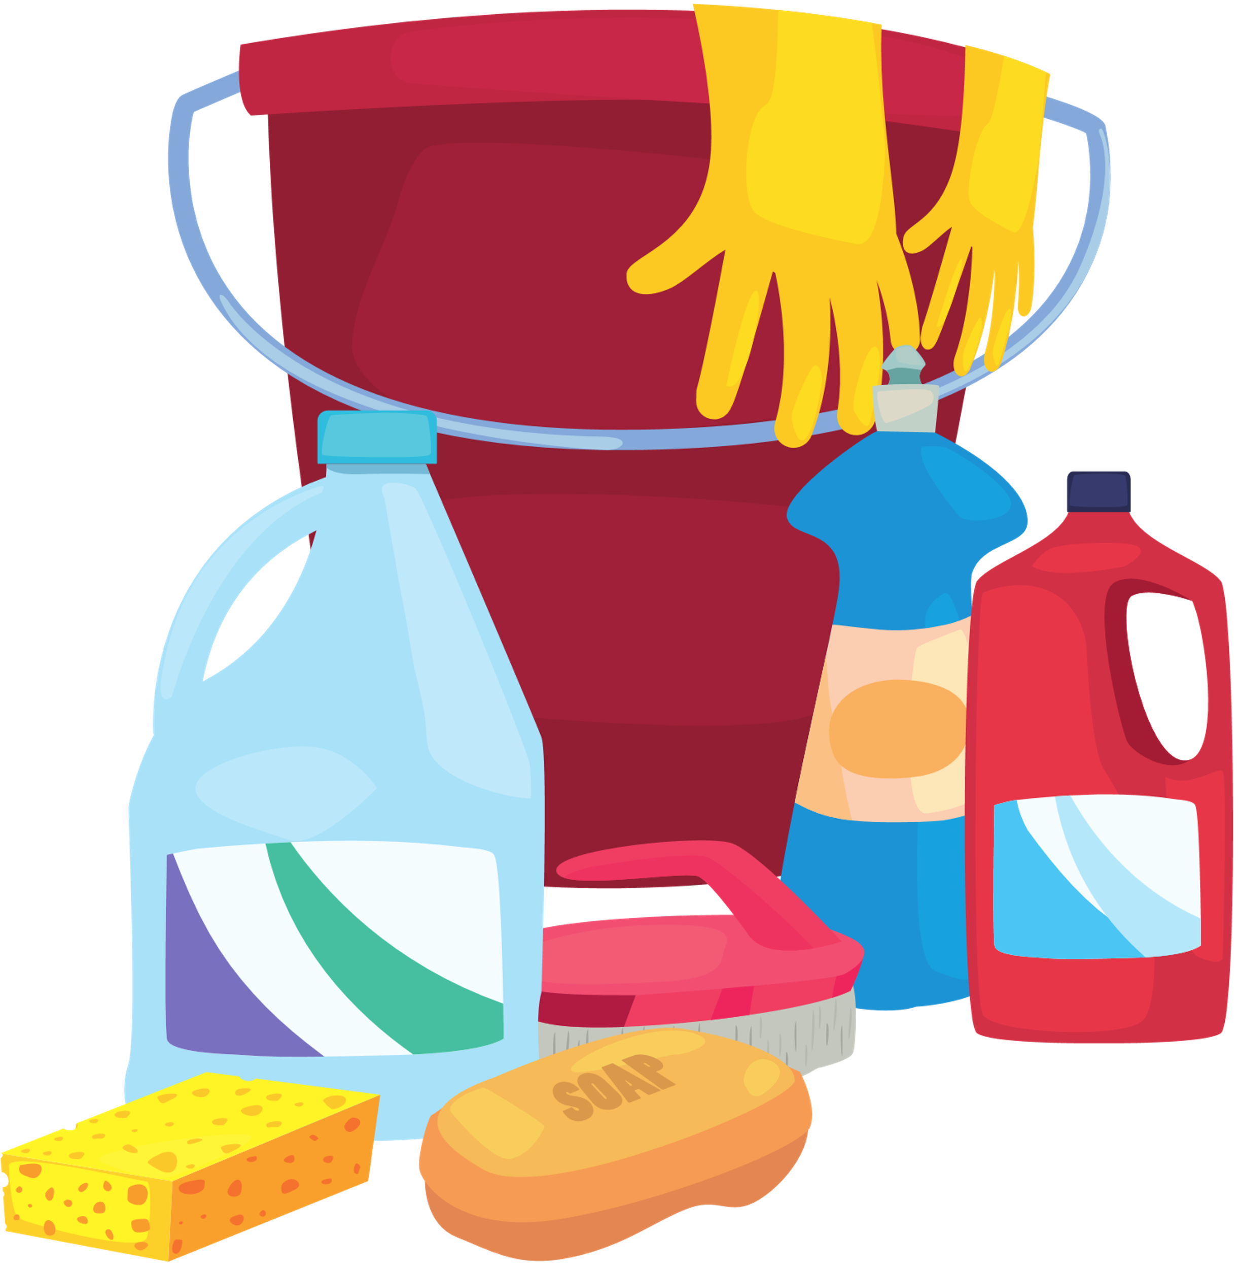
POISON
Children Do Not Know How to Read
It is your job to keep children safe and remove items that could be harmful
Poison Control and Prevention Center
1-800-222-1222
Poisonous Products May Include:
Notes:
Notes: Follow the activity instructions on page 54 by doing a poison look alike game
Say: How do you know what is safe to eat or drink around your house? (pause for response)
Say: One way we know what is safe if by reading the label; however, you will be watching children who might not be able to read. Be sure to keep that in mind, because some medicines look like candy and some toxins might look like juice to little ones.
Do: Activity of poison comparison (Poison Look-Alike test)
(Instructor Guide pages 54-55)

Slide 14
Reflection
Share what you have learned about handling emergencies and one thing that you would like to practice in the next two weeks.
Notes:
Option 1: Say: Grab a sheet of paper and respond to the above prompt. (pause)
Option 2: Say: Turn to page 57, which is worksheet 3. Complete worksheet three. Raise your hand when you are done for my review and signature.
(Instructor Guide page 57)

Slide 15
Emergency Card Game
Notes:
Say: Now, for a little role play! We have a deck of “emergency cards." In pairs/whole group, we will draw a card and two people will act out the scene by following best practices for handing an emergency. After each scenario, we will discuss what went well and what we need to work on. For example, one role play might be a child may have swallowed a handful of vitamins.
Note: example scenarios can be found on page 58 and the correct responses to the scenarios on page 59 of the guide.
(Instructor Guide pages 58 and 59)

Slide 16
WRAP UP
Know about first aid before you start babysitting
Make safe decisions
Keep Calm when handling first aid
Notes:
Say: Great job to everyone in the emergency card game. It is important to prepare yourself to handle a variety of situations through making safe decisions, remaining calm and putting your first aid knowledge to use when necessary.

Slide 17
MEDIA PRESENTATION CREATED BY
UGA FACS Family Life Education Methodology students: Amy Chang, Mackenzie Gay, Elaine Metcalf, and Melina Patterson
Laura Goss, Georgia 4-H Military Liaison from the University of Georgia College of Agricultural and Environmental Sciences Cooperative Extension
McKenzie Tankersley, AmeriCorps Volunteer in Service to America member with Georgia 4-H

Slide 18
REFERENCE
4-H/Army Child & Youth Services Instructor Babysitting Guide, Pages 45-60
Stock Images. (2022). Microsoft PowerPoint.
An Equal Opportunity, Affirmative Action, Veteran, Disability Institution

