Slide 1
Lesson 1: Course Introduction
Notes:
Refer to Instructor Babysitting Guide Sections:
Introduction Section- Life Skills, Character Education and You (pages 1-7)
Lesson 1: Welcome to the 4-H/Army Child & Youth Services Babysitting Course! (pages 8-32)

Slide 2
Learning Objectives
01
02
03
04
05
06
Responsibilities
Character
Competence
Become familiar with the responsibilities of babysitting.
Use the information in these lessons to become capable, caring, trustworthy, and responsible babysitters.
Gain skills needed to be a competent babysitter.
Confidence
Positive Attitude
Business Aspects
Develop the confidence needed to handle situations that could happen while babysitting.
Develop a positive attitude about the care of children.
Be prepared to handle the business aspects of babysitting.
Notes:
Note: Share the expectations listed on the screen
Note: This is a good time to share about lesson structure, timing of the program, and any rules you might have for participating in the program.
Say: As babysitters, your main job is to keep the children safe. This means watching them closely and playing with them. Through this course you will learn what is takes to be a responsible, caring, trustworthy, capable, and safe babysitter. Let’s review the slide to understand our goals for the course.
(Instructor Guide page 3)

Slide 3
Spinning a Yarn
Image from Microsoft PPT Stock Images
Notes:
Note: Rename the slide for whatever game you choose to get to know the youth. It is important to take time to learn the youth’s name to build connection. Focus on learning names and building an atmosphere of trust and openness.
Note 2: The following are the suggested instructions for the Spinning a Yarn game but you can also find other activities on page 11 of the guide as well.
Say: I am going to pass around a ball of yarn. You will need to cut off a piece that is a yard long. Once you have your yarn cut please begin to form a circle.
Say: In a moment but not yet you will share anything you like about yourself. You can share about your siblings, your favorite hobbies, a movie you saw recently, or even your least favorite food. The catch is while you share you be wrapping the yarn around your finger. The yarn is your timer. You should fill the time with information but be sure to wrap up once you are out of yarn.
Say: Alright, let’s begin by getting in a circle and getting our yarn cut.
Say: Now, that we are ready I will demonstrate how to participate and then will move around the circle Right to Left. (provide an example and be sure to wrap the yarn around your finger).
(Instructor Guide page 11 with this and other activities)

Slide 4
What is 4-H?
Notes:
Say: 4-H is a nation-wide youth development organization which offers support and educational opportunities to youth ages 5 through 18. It has a 100-year history of successfully meeting its mission. The Babysitting Curriculum is only one of its many programs.
(Instructor Guide page 3)

Slide 5
What is Army Child and Youth Services?
Notes:
Say: Army Child and Youth Service provides child care and youth activities during out of school time to support the Army Workforce. Child and Youth Services offers a variety of full day, part day, hourly and outreach options for eligible child and youth ages 4 weeks to 18 years. In 1997, Military Child Care was designated by President and Mrs. Clinton as the “model for the nation.” The Army Child and Youth Services played a major role in creating this babysitting curriculum. However, please note that the AIr Force, Navy, and other branches also offer services on installations for children and teens too.
(Instructor Guide page 3)

Slide 6
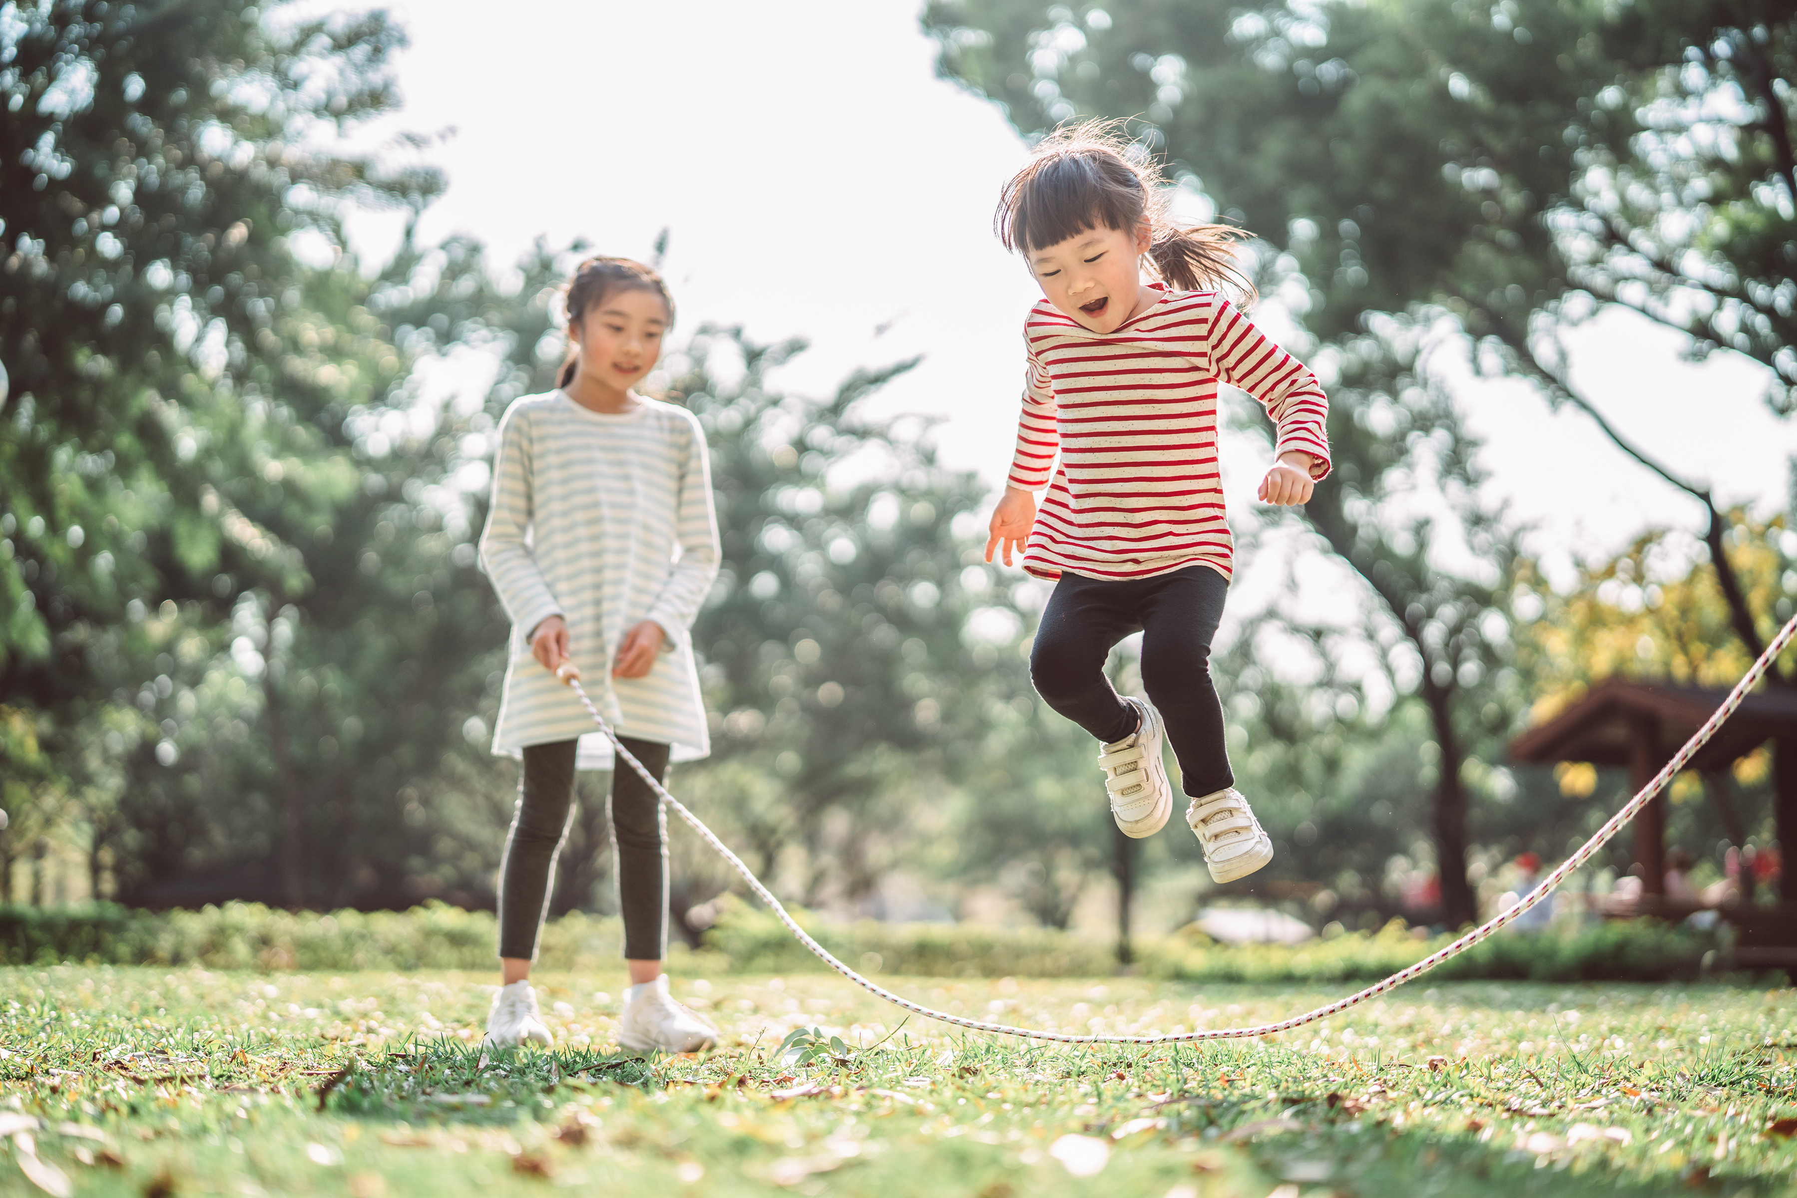
Lets Jump into our topic!
Image from Microsoft PPT Stock Images​
Notes:
Note: introduction slide to move to the focus on What is Babysitting.
Say: Now that I know a little more about you from our Spinning Yarn activity and we covered the authors of this curriculum let’s jump into our topic for today.

Slide 7
Think:
What is one of your favorite memories from early childhood?
Notes:
Note: the next slides provides activity instruction. This slide is meant as a personal reflection (allow youth a few moments to consider this silently or out loud)
(Instructor Guide Page 11)

Slide 8
Share:
With a partner or group, share:
Why are those your favorite childhood memories?
If anyone in your group has babysitting experience, discuss memories they have from that.
Share six characteristics you think a babysitter needs.
Follow Along: Handout page 12
Notes:
Note: Depending on your set up edit slide to either say group or partner, but not both.
Note: Handout is provided on page 12 for youth to complete and assist with visual learners.
(Instructor Guide pages 11-12)

Slide 9
Babysitter’s Knowledge Survey
Take some time to read and fill out the Babysitter’s Knowledge Survey.
Notes:
Note 1: For this section, the teens will fill out the Babysitter Knowledge Survey in Lesson 1 page 14 and the key can be found on page 15.
Note 2: The following slides ask questions for the group to respond to. You can delete those if you choose to do the individual handout; however, the group experience might save time if needed.
(Instructor Guide pages 14-15)

Slide 10
What is your Babysitting knowledge?
What is wrong with the following statements?
1. The main responsibility of a babysitter is to make sure the child/ren have fun.
2. You can feed children 0-5 grapes, uncut carrots, and hotdogs.
3. It is not necessary to wash dishes you use while babysitting.
4. It is safe to leave the bay on the changing table to answer the phone.
Notes:
Note One: this is an adapted version of the Babysitter Knowledge Survey.
Is False. The answer is safety
Is False. Different ages require different food preparation and 0-5 can not swallow and chew as easily, so we have to cut certain food items up. We learn more about food safety soon.
Is False. It is always a good idea to be mindful of cleaning up after yourself and the youth you are watching.
Is False. Be mindful of where you leave baby and consider what could happen before walking away. We learn more about safety soon.
(Instructor Guide page 14)

Slide 11
What is your Babysitting knowledge?
Let’s Think it Out
1. Whose numbers should you know to contact in case of an emergency?
2. Babysitters should…
A. Allow pacifiers with strings or ribbons to be placed around the baby’s neck
B. Shake the child to it to stop crying
C. Put infants to sleep on their stomach
Notes:
Note One: this is an adapted version of the Babysitter Knowledge Survey.
Parent/guardians of the child, Neighbors, Emergency numbers like 911 and poison control
Baby's should not have any strings attached to the pacifiers, there are alternative soothing techniques beyond shaking, which actually is harmful and disorienting for a baby, and babies should lay on their backs to sleep.
(Instructor Guide page 14)

Slide 12
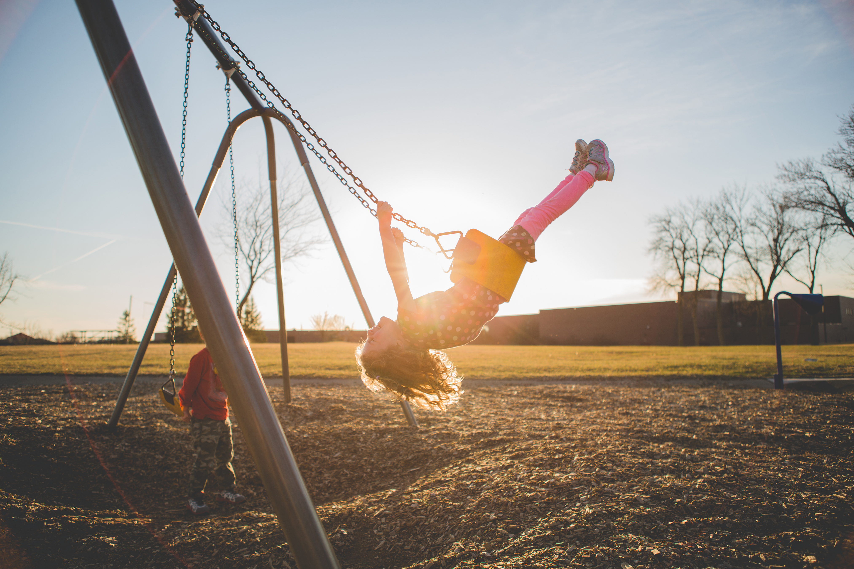
Take a break!
Image from Microsoft PPT Stock Images​
Notes:
Note: This is an optional break to provide a chat time, bathroom break, and a pause before more learning. Remove this slide as needed.

Slide 13
Am I the right person to be a babysitter?
Notes:
Note: For this section, the teens will fill out the Babysitter Questionnaire (p 17).
(Instructor Guide pages 16-17)

Slide 14
Action:
Role-play a situation where…
Babysitter
Parent/Guardian
One person is the babysitter who just arrived on the first day working for this family. ​
The other person is the parent/guardian who is informing the babysitter of the children’s needs.
Notes:
Say: With a partner, you will conduct an interview to learn about the expectations of babysitting for that family and anything you might need to know. One of the partners will play the babysitter and the other will play the parent. Let’s make one round realistic and the other you can choose your favorite TV/Tik Tok, YouTube influencer, or the like to add a fun spin to it. For example, in round 1, I will portray a parent with two kids from our local area and in round two, I will portray Bat Woman who is in need of a nightly babysitter. The babysitter should ask questions to ensure they are ready to take on their role. If you are the parent be sure to answer the babysitter questions and share additional things you think a babysitter should know.
(Instructor Guide pages 26-27)

Slide 15
Action:
Let’s use our five senses
Notes:
Instructor Do: Hide food or substances around the room (check for allergies/disabilities in advance).
Say: You will have 3 minutes to find # of objects around the room. The objects might be smelly like an old onion, things with a different feel like sandpaper and macaroni noodles, or things with different taste like an ice cube.
Instructor Do:Allow youth to find different objects.
Say: Now, sit quietly where you are. Please no talking or whispering during the next activity. For the next 2 minutes I want you to listen.
Instructor Do:Now, write down all the random big and small noises you heard.
Say: Now, let’s taste some food (prepare food items in advance). With your eyes closed with a partner you will trade off tasting the food items. For example, I will try the food in cup one with my eyes closed and try to decide what it is on taste alone.
Instructor Do: Allow youth to taste food.
Say: The last sense we have left is? That’s right touch! In each of the brown bags/boxes I have random objects. Using only your hands without peeking I want you to decide what is in the bag/box. Don’t say what it is until I ask the group to share.
Instructor Do: Share what is in each box with the group.
(Instructor Guide page 22)

Slide 16
Reflect:
Let’s use our five senses
What activity was your favorite?
Why did we do that?
What senses are required for babysitting?
Notes:
Note: Ask the questions on the screen and wrap the activity up.
(Instructor Guide page 22)

Slide 17
What is in your babysitter magic bag?
Notes:
Note: This is an activity where the facilitator has the teens draw a bag on a piece of paper and say what they need to put in their “magic bag” to be the best babysitter they can be.
Note: The Magic Bag is also a great reward for the end of the certification. Consider funding for supplies, so each teen receives a Babysitter Bag at the conclusion of the certification.
(Instructor Guide pages 18-20, worksheet on page 20)

Slide 18
What are some possible joys of babysitting?
Reflect and share some joys you may experience while babysitting.
Notes:
(Instructor Guide page 21)

Slide 19
What do I need to know to be a babysitter?
Team up!
List it!
Share!
Get into teams of three to five.
Make a list of everything you need to know about how to be a babysitter.
Share what your team discussed with the whole group.
Notes:
Note: Use the handout on page 23 as a reference to help ensure teens think about the various things.
(Instructor Guide page 23)

Slide 20
Do!
Share!
Act!
Act as the “family” and fill out the Family File and Job Log
Share with the group or a friend the rules of your family.
Use the Family File and Job Log when you babysit for the first time after completing this course.
Notes:
Note: There is a handout you can print for the teens, or you can have the teens fill out an electronic PDF. The PDF is in the resource folder or found on page 24 of the guide.
(Instructor Guide pages 24-25)

Slide 21
Babysitter’s Report
Share how the children did while in your care
Notes:
Say: Parents want to know how their children did. This includes if they listened to you, what they ate, and if you played any games. Provide examples or share a story from your time with their child. A statement like “they were good” is not enough details. A statement like “Johnny did great playing Clue with me and even ate all his food.” In some cases you might choose to create a chart with details to include the bathroom, food, activities, listening, and other relevant categories depending on the child's age. There is an example on page 30 if you would like to incorporate that into your babysitting routine.
(Instructor Guide pages 28-30)

Slide 22
Share
What is one thing that makes you a good babysitter?
Notes:
Say: Take a second to reflect on everything we have discussed today and think about something that makes you a good or awesome babysitter. Reflecting on your good qualities could help you when you are trying to market yourself as a babysitter in the future.

Slide 23
Reference:
4-H/Army Child & Youth Services Instructor Babysitting Guide, Pages 1-32
Stock Images. (2022). Microsoft PowerPoint.
An Equal Opportunity, Affirmative Action, Veteran, Disability Institution

Slide 24
Media Presentation Created By
UGA FACS Family Life Education Methodology students: Amy Chang, Mackenzie Gay, Elaine Metcalf, and Melina Patterson
Laura Goss, Georgia 4-H Military Liaison from the University of Georgia College of Agricultural and Environmental Sciences Cooperative Extension
McKenzie Tankersley, AmeriCorps Volunteer in Service to America member with Georgia 4-H

