Slide 1
Simple Survey Resources
Jeff Buckley, Jennifer Cantwell, Casey Mull, Whitney Cherry, Julie Dillard, Nicole Crawson
Notes:
You don’t have to be an expert. The people who read our reports and media are not experts either.
Just make one, hand it out and see what you get!
Take a stand exercise:
I have a basic knowledge of program evaluation.
I have an advanced knowledge of program evaluation.
I am comfortable developing my own surveys.
I am comfortable tabulating my own data.
We will

Slide 2
Topics we will cover…..
General Evaluation Overview:
Why and what do we evaluate?
Outcomes → Constructs → Questions
Review of Templates
Create your own – hands on
Tabulation
Impact Statements
Notes:
Jeff
We will talk about all these things today…

Slide 3
You will leave with….
Resources for developing effective survey questions
3 Survey Templates
Resources/tools for collecting and analyzing data
Sample impact statements
Notes:
Jeff
We will talk about all these things today…

Slide 4
Disclaimers
Adapted from previous presentations by Jeff Buckley, Jenna Daniel & Casey Mull.
Resources developed in collaboration with Nick Fuhrman, Ph.D., Associate Professor & Graduate Coordinator, Dept. of Agricultural Leadership, Education, & Communication, UGA.
Consult with your state’s Evaluation Specialist for additional, more advanced, guidance on Program Evaluation.
We welcome your constructive feedback as we work to provide useful resources in the area of Program Development.
Notes:
Jeff
Note – These resources were developed in collaboration with Dr. Nick.
The templates we will discuss today are useful for gathering short term data on a single day of programming.

Slide 5
Why is it important?
As a result of shrinking state budgets, the need to effectively document program impacts is more critical than ever.
Many states do not have a full time Evaluation Specialist.
County Agents and State Specialists must develop their own evaluation instruments.
Many County Agents and State Specialists may not feel qualified or confident enough to develop their own instruments and/or to tabulate and report data.
Notes:
Jeff

Slide 6
Things to consider
Who is your audience?
Process Evaluation – Internal Use
Outcome Evaluation – External Audience
How will you share the results?
Impact Statement
News Article
Journal Article – Be sure to check with IRB!
Other
Notes:
Jeff
Ask them why they want to gather data? Who’s it for? What do you plan to do with it? These are all big questions we won’t answer today.
Today we’re focusing on a simple method of gathering data, that is adjustable to a variety of programs.
Begin with the end in mind.
Is this to publicize your positive impact or two help improve your program
Process – how did we do?
Outcome – did your learner/stakeholder/participant they learn as a result of it?

Slide 7
Institutional Review Board (IRB)
Research oversight committee charged with ensuring that human subjects research is conducted in compliance with the applicable federal, state, and institutional policies and procedures.
Notes:
Jennifer

Slide 8
When is IRB-approval needed?
When using results for:
Research
You plan to generalize the information learned
Scholarly article or report
Not required for:
Evaluation
Internal use – program improvement, etc.
Reports to: Funders, stakeholders, media, impact statements, news articles, etc.
Notes:
Jennifer
Hypothesis – you have a question you want to answer - if kids participate in this program, they’ll have this result
Generalize – if you implement this program exactly the way we did, your kids will have these outcomes

Slide 9
Important Terms
Outcomes – benefit to participants
Related to knowledge, skills, attitudes, behavior, condition, or status
We might also refer to this as a desired outcome or the objective being measured via the survey
Constructs – grouping of questions that measure an outcome
Impact statement – summary of program outcome as measured by survey
Notes:
Jennifer
There are many other evaluation terms that come into play when doing program evaluation, but these are the main ones we will use today.
The big thing to remember is outcomes are the BENEFIT where
outputs are the NUMBER of activities provided.
We are looking at benefit to the participant.

Slide 10
Types of Outcomes
Short-term
New knowledge, increased skills, changes in attitude or values
Intermediate
Modified behavior
Long-term
Improved condition, altered status
Notes:
Jennifer
Examples
Short – gained or demonstrated knowledge, changed their belief, say they plan to do something different
(they now know exercise is important and they plan to do it)
Intermediate – actually change behavior (increased exercise)
Long-term – they are healthier (lose weight, better blood pressure, etc.)

Slide 11
What can our surveys measure?
Short-term Outcomes
Knowledge
Increase in knowledge
Demonstration of knowledge
Attitude or Values (behavioral intent)
As a result of intervention, I plan to….
Skills
Notes:
Jennifer
Short term, not long term
But…, we can tie short term outcomes to the research from Tufts, that 4-H is beneficial.
We are getting a snapshot of one effective day of programming.
Develop one question from each of the above areas, share briefly, go on.
The templates we will share with you address the first two bullets.
Example of Skills – use rubric example

Slide 12
Outcomes
Examples from your programs?
Notes:
Jennifer
One minute for this slide
In the case of developing the survey, the outcome/objective is the benefit we are hoping that the participant will get from our program.
It’s good to have ambitious objectives. However, when your goal is to measure impact, it’s important to identify simple, clear and measurable objectives. This is not a simple process and can take a fair amount of time.
However, we have a handout to help guide you in the development of clear objectives.
Clear objectives will translate into more effective constructs and questions.
Refer to handout on Measurable Verbs.
We won’t have time to get into this today, but the quality of your data depends on the quality of your objectives, questions and constructs.

Slide 13
Measurable Outcomes
Refer to the handout “Verbs for Writing Measurable Objectives”
Measurable objectives will translate into more effective constructs and questions.
Constructs are sets of questions designed to measure a single idea.
Notes:
Jeff
One minute for this slide – A resource for you.
It’s good to have ambitious objectives. However, when your goal is to measure impact, it’s important to identify simple, clear and measurable objectives. This is not a simple process and can take a fair amount of time.
However, we have a handout to help guide you in the development of clear objectives.
Clear objectives will translate into more effective constructs and questions.
Refer to handout on Measurable Verbs.
We won’t have time to get into this today, but the quality of your data depends on the quality of your objectives, questions and constructs.

Slide 14
Simple Example
Program teaches youth to make healthier food choices and to increase activity.
Short-term Outcomes
Youth are able to identify healthy food choices
Youth plan to increase exercise and decrease screen time
Notes:
Jeff
In this example, we have an overall goal that youth will make healthy choices – in this case, our outcome has two construct areas – healthy food choices and increasing activity

Slide 15
Creating a Construct: Don’t put all your eggs in one basket
Youth are able to identify healthy food choices:
I know more about what foods are healthy.
I can identify healthy food options.
I have learned new ways to eat to be healthier.
Youth plan to increase exercise and decrease screen time:
I learned new ideas for being active.
I plan to exercise more.
Decreasing screen time is a healthy choice.
Notes:
Jeff
Building a construct means, coming up with multiple questions designed to measure the same concept. If you only have one question, poorly worded, you might not get valid data because the question was confusing. So ask several questions targeting the same outcome/construct/learning objective.
Youth are able to identify healthy food choices
Youth plan to increase exercise and decrease screen time

Slide 16
Creating a Construct: Don’t put all your eggs in one basket
I know more about what foods are healthy.
I learned new ideas for being active.
I can identify healthy food options.
I have learned new ways to eat to be healthier.
I plan to exercise more.
Decreasing screen time is a healthy choice.
Notes:
Jeff
Building a construct means, coming up with multiple questions designed to measure the same concept. If you only have one question, poorly worded, you might not get valid data because the question was confusing. So ask several questions targeting the same outcome/construct/learning objective.

Slide 17
Evaluation Templates
Purse Strings and Heart Strings
Quantitative and Qualitative Data
Post-test Only
Retrospective Post then Pre
Quiz-like, post-test only
Audience Poll Documentation Form
Notes:
Jeff
There are many different types of evaluations/surveys that are important. We are going to go over the last 3 on this slide, but wanted to mention others.
Quantitative is for the numbers people (purse string$) - Numbers
Qualitative is where we get sweet stories to tug at – stories
Also, the quantitative doesn’t allow you to gather info on things you haven’t thought of. The open ended lets you gather info you didn’t know you needed.

Slide 18
Notes:
Jeff
Likert-style questions
You can use do pre-test and post-test

Slide 19
Notes:
Jeff
Likert-style questions
This accomplishes pre and post test

Slide 20
Likert Style Questions
These templates are designed for use with Likert style questions.
Pick the rating scale that works best for your objectives/program (see handout).
This is the most challenging part of developing your survey. Allow time. Ask for feedback.
Notes:
One minute for this slide
HANDOUT
The real trick to creating these evaluations is coming up with a set of questions that can all use the same rating scales.
It takes some time and effort. Ask for feedback from a colleague. Maybe develop two different surveys with slightly different wordings to see which ones get better responses.

Slide 21
Points to Consider when Writing Likert Style Questions/Statements
Consist of a statement and a rating scale.
Need to conform to one rating scale.
One data point per question.
Is what you’re measuring important to the intended audience of the evaluation?
Notes:
One minute for this slide
Present the template for the Standard Questionnaire
When using a “Likert” style questions, you must conform to the format. Refer to the Sample Ratings Scale Handout
Standard Questionnaire versus Retro Post then Pre – Both have their pros and cons.
0

Slide 22
Activity - Build Your Own Survey
Pick a Survey Template
Develop 6 Likert Style Questions
2 outcomes (constructs) - 3 questions for each
3 outcomes (constructs) - 2 questions for each
Consider…
What you want your participants to know?
How you want their attitude to change?
What sort of behavior changes you want to see?
Notes:
Jeff and Florida
One minute for this slide
In order to use the provided templates we recommend that you pick
Maybe we have some objectives and we brainstorm, or we have 2 or 3 objectives and ask them to write questions for them, creating a construct around 1 of the 2 or 3 objectives.

Slide 23
Process Activity
How did it go?
Was it difficult?
What did you learn?
Do you think this is a helpful template for producing a usable survey for certain programs?
Notes:
Jeff and Florida

Slide 24
Demonstration of Knowledge
Notes:
Jennifer

Slide 25
Notes:
Jennifer
This surveys is what we call a Quiz-like survey. You could use it as a pre and post test, but we have been using it as a post-test only.
CCRPI – we made these based on state requirements – we had some objectives given to us.
In some cases the blocks of questions are constructs, in some cases they are different.
Demonstration of knowledge – what we want them to learn – we make them give the answer.
There are some questions that are YES/NO or TRUE/FALSE that might fit into Likert Style. These are meant to be kid –friendly.

Slide 26
Notes:
Jennifer
Matching, multiple choice, fill-in-the-blank,etc.

Slide 27
Now, gather your data!
Hand out your questionnaires.
Take them back up.
Open up your tabulation template
Notes:
Casey
Hand out class
Click on tab. Copy to create a new one. Enter Program title, date, etc….
Enter two cells
Look at a populated, completed tabulation sheet.

Slide 28
Analyzing,
Tabulating and
Reporting Impact
Notes:
Casey
Start entering data into the template… As time permits.
We can open up one that already has some data in it.

Slide 29
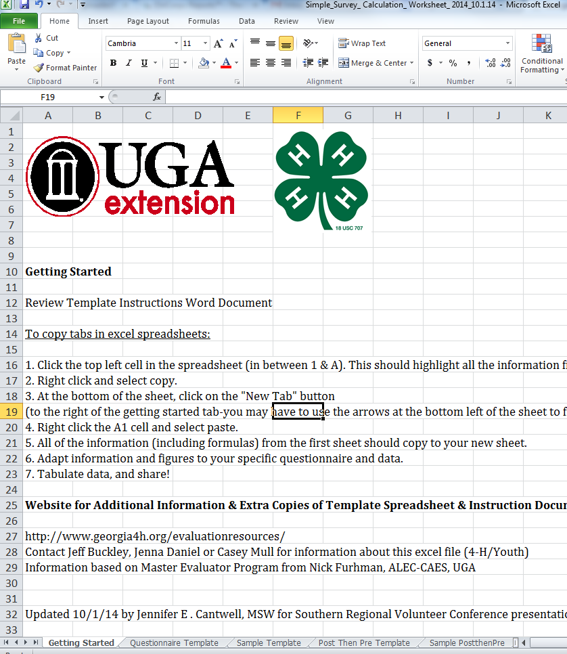
Screen shot tab spreadsheet
Notes:
Casey
These are for the two Likert style templates – post-test only and retro post then pre
We have a retro post then pre version with more participants.

Slide 30
Notes:
Casey

Slide 31
Notes:
Casey

Slide 32
Sample Impact Statements
Overall respondents indicated they agreed they are more likely to get involved in their community as a result of the GPK Leadership Adventure weekend.
Notes:
Casey
Share how data can be utilized to create impact statements and show/report data.
Refer to the handout and create some sample statements…
I’ll type some up for the slide.

Slide 33
Sample Impact Statements
In general respondents disagreed that they would maintain their involvement in the GPK program.
70% of respondents agreed or strongly agreed that they had made friends with other kids in the GPK program.
Notes:
Casey

Slide 34
Sample Impact Statements
For the retrospective post then pre questionnaire, you could utilize responses like:
84.6% of respondents indicated an increase in their confidence concerning their ability to design or construct a map of the distribution of major world languages.
Notes:
Casey

Slide 35
Sample Impact Statements
The percentage of program participants who agreed that they were confident in their ability to develop measurable objectives increased from 38% before to 100% after the program.
Notes:
Casey

Slide 36
Notes:
Jennifer
Calculation Template for CCRPI surveys created – specific to surveys.
We will create templates in the future. Let us know if you need help!

Slide 37
Notes:
Jennifer

Slide 38
Notes:
Jennifer

Slide 39
Sample Impact Statements
Outcomes with 1 question/construct:
68% of students correctly identified the United States government as the largest employer in the world.
72% of students stated they thought about different careers they might like when they are older.

Slide 40
Sample Impact Statements
Outcomes with multiple questions/constructs:
92% of students correctly matched at least 3 of the Government/Public Administration jobs to the appropriate department.
91% of students correctly identified at least 3 of the government departments with the type of assistance provided.
Notes:
Jennifer

Slide 41
Simple Surveys in Florida 4-H

Slide 42
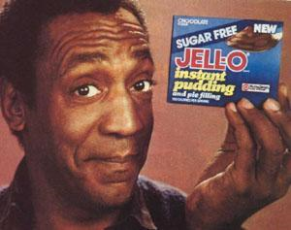
Notes:
UF/IFAS Extension girls:
So basically, this slide says it all. The proof is in the pudding. We were first trained at a conference in Georgia, and when we went back to Florida, our minds were blown at the simplicity of this system for program evaluation. We were anxious to put it to work and see if it is as good as it sounds. And the truth is, it was….
We started using the system in our three counties, and once we were satisfied we pitched it to our 16 county administrative extension district for a volunteer training program. They loved it, and now we are using it to show district wide impact for:
Counselor training
The Florida 4-H Tropicana Public Speaking program
End of year volunteer/club member survey
Ag awareness programs
Volunteer training programs
We have also begun evaluating a state-wide volunteer training program, and a state SPIN club pilot with this system.
So, as you can see, we are big fans of this system for program evaluation, but we knew we had a winner when after one 15 minute abstract session at our state meeting last year, we were getting questions for other district directors and agents in other program areas. So, the program is not only easy to use, and easy to report from, and is translatable across a variety of programs and program areas.
We’ve been very clear from the get-go that all the credit for program development goes to our friends from UGA, to whom we are so thankful for sharing this opportunity with us, and we are extremely grateful for the continued support they’ve shown us as we modified their spread sheets, and templates to accommodate our needs. We now have templates and spread sheets that will calculate data for anything from 1-10 questions and 1-1500 participants. That’s beneficial when we are looking at district and state-wide programs with hundreds of participants. Many members of our office staff have been trained to input data, and they prefer this system to hand grading pre and post tests and creating their own spread sheets as we were in the past, so ….

Slide 43
Notes:
UF/IFAS Extension girls:
As anyone who knows us, quickly finds, we’re very skeptical about “magic cures” to our extension ills, but after a taste test of this program, we can say, we like it. We really like it.
Questions…..

Slide 44
To Access Templates, go to… www.georgia4h.org/evaluationresources
For more information contact: University of Georgia, State 4-H Office
Jeff Buckley, jbuckley@uga.edu
Jennifer Cantwell, jecantw@uga.edu
State 4-H Office – 706-542-4444

Slide 45
For more information contact: University of Florida Extension
Whitney Cherry, cherryw@ufl.edu
Julie Dillard, juliepd@ufl.edu
Nicole Crawson, ncrawson@ufl.edu

Slide 46
Questions, suggestions for improvement? Thank you for coming.

