Slide 1
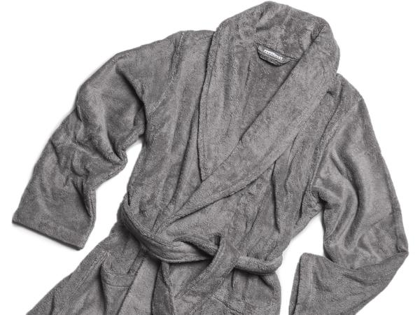
Bathrobes
Georgia 4-H Cotton Boll & Consumer Judging 2017

Slide 2
A Bathrobe?
The bathrobe has been around as long as the public baths that were popular in ancient cultures like Rome, Turkey and China.
Depending on what you’re looking for, buying a bathrobe can be very simple or extremely complicated. After all, all bathrobes are not created equal; they vary in quality, are available in a variety of different materials and offer many options from which to choose. The following are some key points to consider when selecting a bathrobe.

Slide 3
Choosing the Fabric!
Fabric is the most important feature of a bathrobe. The fabric defines the touch and feel, absorbency, and the overall weight of the robe.
Fabric types can range widely from traditional cotton and classic satin to warm cashmere and plush microfibers. Your intended use for the robe will dictate what fabric is best for you. Most robes are used straight out of the shower and/or for lounging around the house.

Slide 4
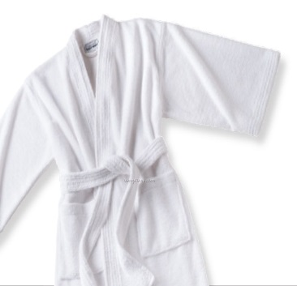
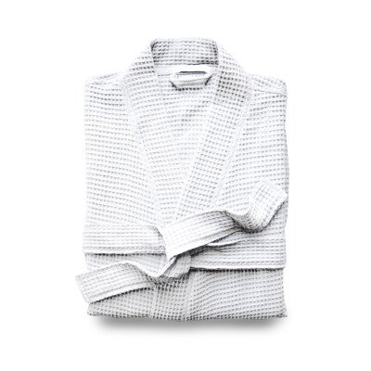
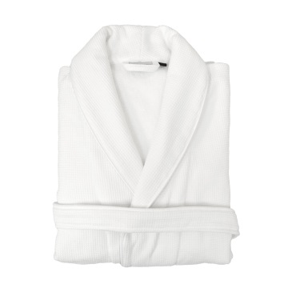
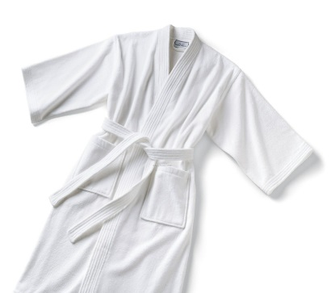
Robe Fabric Pros and Cons
Microfiber Robes
Pros: Good water absorption, ultra-light weight, soft feel.
Cons: Luxury microfiber robes can be more costly than traditional terry robes.
Cotton Waffle Robe
Pros: Inexpensive. Ideal for bulk purchasing for hotels and spas. Make good gifts.
Cons: Not as soft as other robes. Potential for shrinking.
Cotton Terry Robe
Pros: Good water absorption. Commonly found in typical spas and hotel rooms.
Cons: Cotton terry robes can be heavy and bulky. The robes are prone to shrinkage if not pre-shrunk.
Cotton Velour Robes
Pros: Soft to the touch. Warm and insulating.
Cons: Bulky and heavy. More expensive than other cotton robes.

Slide 5
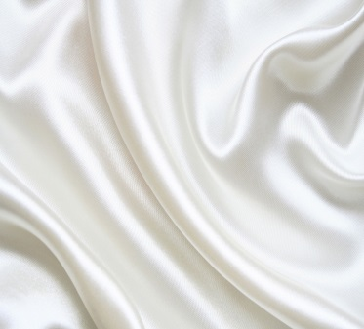
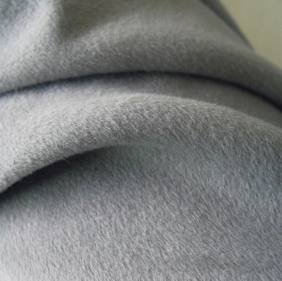
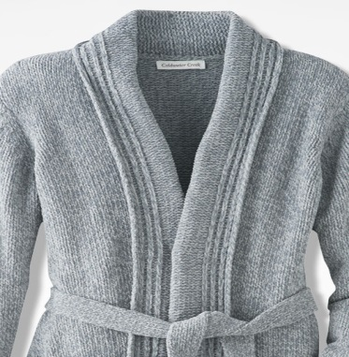
Robe Fabric Pros and Cons
Satin & Silk Robes
Pros: Silky feel. Light weight.
Cons: Not ideal for spa use due to delicate care and low water absorption ability.
Cashmere Robes
Pros: Warm and soft. Light weight.
Cons: Very expensive for high quality cashmere. Lack of water absorbency. Must be dry cleaned.
Chenille Robes
Pros: Warm and soft. Light weight.
Cons: Can lose shape after washing. Quality of chenille varies drastically. Low water absorption.

Slide 6
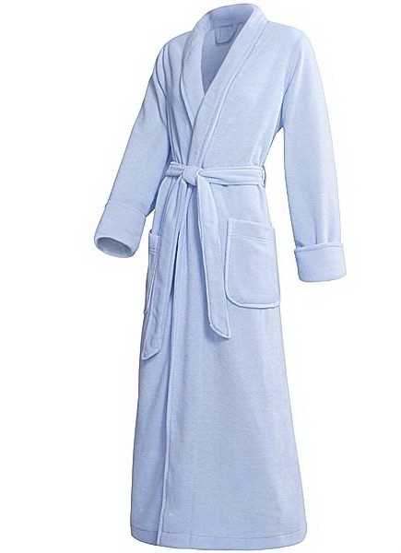
Different Styles
Full length bathrobes
These bathrobes are usually made up to 59" and must come all the way to your ankles. These are called 'floor length' or 'ankle length' bathrobes.
To choose one, measure your height and then check the 'length' column on the size chart of the bathrobe.
Unfortunately, some of the bathrobes in the market are 'OSFM" (One Size Fits Most) or 'OSFA' (One Size Fits All).
Both sizing’s are expected to fit everyone. It doesn't matter if you are too tall or petite, curvy or skinny. It's better to choose a bathrobe that comes in multiple sizes.

Slide 7
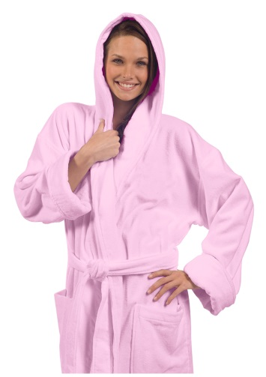
Different Styles
Mid-calf length
These bathrobes come between your knees and your ankles.
Short
These come to your knees and can be used in warm climate.
They are ideal as summer bathrobes. These are also perfect for traveling or using in the hospital or poolside.
Hooded
A hooded bathrobe is generally used after your shower for drying wet hair.
This type of robe is ideal for those with longer hair who want to dry their hair faster after they shower. These are ideal for the pool as well.

Slide 8
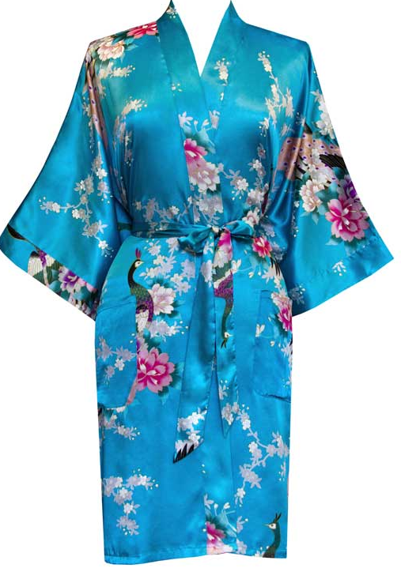
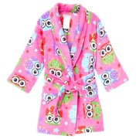
Different Styles
Kimono style
These bathrobes are usually mid-calf length or short. They do not have hoods and they are light in weight.
These are perfect for traveling.
Kids
Kids robes are often styled just like adult robes. However, fabrics and patterns may vary.
Robes for children may offer special flame- resistant or flame-retardant finishes.
Light-weight
If you need a bathrobe for hot summer days and do not want a thick-heavy bathrobe, light weight ones are perfect for you.
These styles are also chosen by spas and hotels due to low price and ease of use in multiple washings.

Slide 9
Selecting the Robe Size
No matter where you buy a robe, you should be aware of one size fits all robes. If you are lucky, you can spend many hours a day in your comfortable cozy robe. So why would you purchase something that wasn’t sized to fit you well?
If you are buying a robe for a friend or a loved one, you want to give them an option to exchange it for a different size if it doesn't fit well.

Slide 10
Why are there so many one size fits all or one size fits most robes?
Manufacturers introduced one size fits all apparel to minimize the amount of inventory they have to carry.
For example, the hospitality industry buys a huge volume of robes to accommodate millions of guests in hotel rooms, day spas, and resorts. One size fits all was an inexpensive way for hospitality providers to furnish their rooms without having to deal with an assortment of sizes and at the same time simplify their house-keeping operations.
However, if you are an individual customer, get the most for your money by purchasing a robe that fits you.
In general, no matter where you purchase your robe from, make sure the retailer offers several size options. It doesn't make sense to spend money on a robe that does not fit.

Slide 11
Bathrobe Color
After choosing your size and style, the last thing to do is to choose your favorite color.
Be careful to read the fabric care and washing instructions when buying a colored bathrobe as the color may fade after multiple washings.

Slide 12
Features and Other Considerations
Other important features to consider when purchasing a robe are:
The construction of the robe. Even if the fabric is the same, not all robes are constructed equally.
Features such as shawl collars, cuffs, generously sized pockets, and inside ties. A shawl collar adds a classic elegant look to the robe. In a bathrobe, it can also be used to help dry the neck and face.
A robe tends to come undone when you are moving in it. Inside ties can provide added support and security.
Pockets, zippers and button closures are wonderful features of any robe, and add warmth and extra security.
Check the price tag. Bathrobes come in a range of prices, ranging from well under $20 to several hundred dollars. Purchase a quality robe that meets all your needs.
A bathrobe is a luxurious and comfy wardrobe staple. Whether you love to snuggle up in a robe after a long bath or shower or a robe is your go-to garment to throw on during your morning routine, a good bathrobe is a comfort essential. Quality bathrobes can last for years, so it's important to find the right one that you know you will like before you invest.

